Slide 1


Industrial wastewater reuse systems
The future is water reuse

Slide 2


Spacedrip is an Estonian tech company with a vision for healthy and sustainable use of Earth’s most vital resource — water
Founded in 2020 — Spacedrip has developed systems that provide wastewater treatment and water reuse systems for defence, emergency, industrial sectors, and off-grid and urban communities.
Our goal is to build water resilience by decentralizing water management with onsite water reuse
01

Slide 3
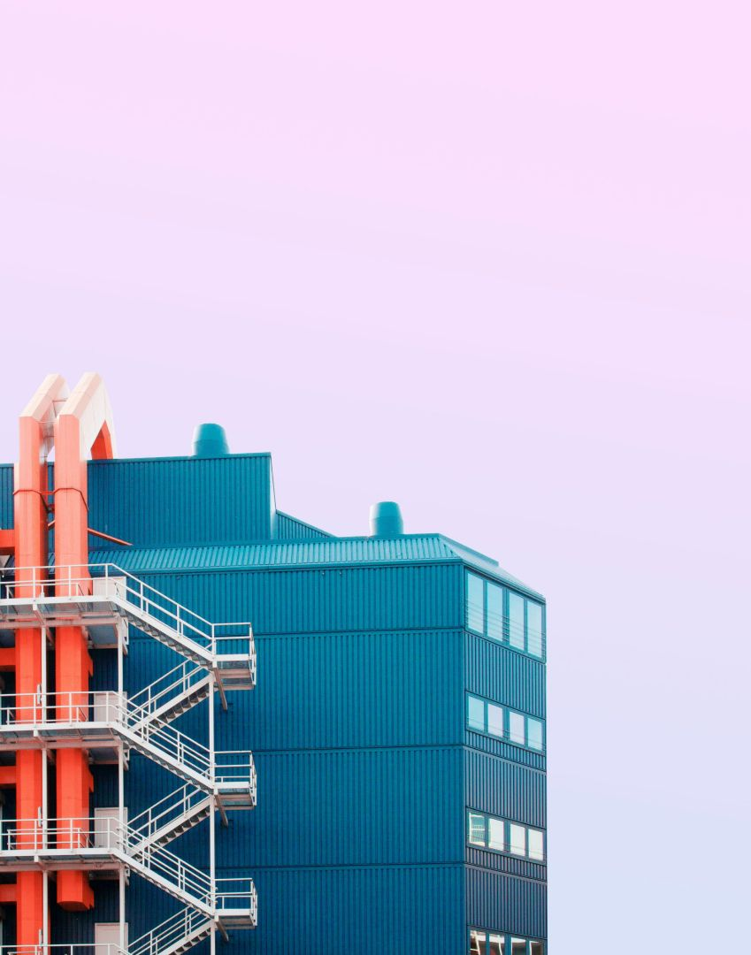

Water challenges for the industrial sector
Stringent Regulations - Navigating complex environmental compliance standards.
Excessive Water Consumption - Inefficient processes lead to significant water waste.
High Water Prices - Escalating costs amplify the impact of water inefficiency.
ROI Challenges - Demonstrating favourable returns for wastewater projects.
02

Slide 4

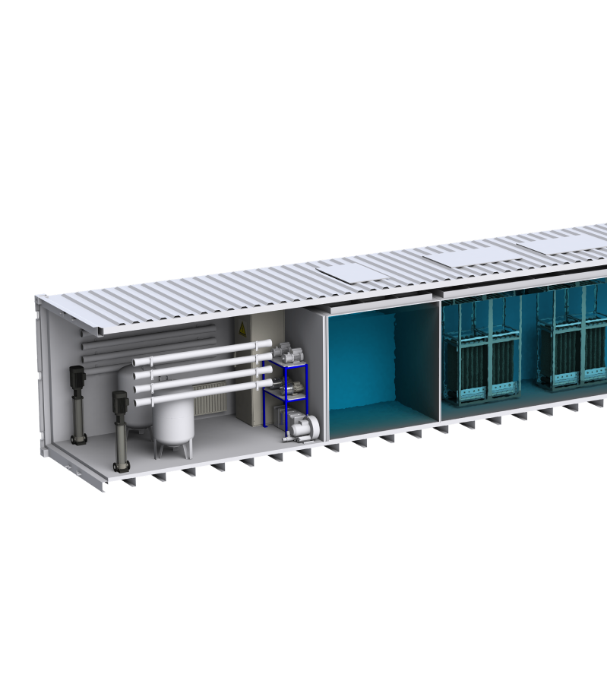
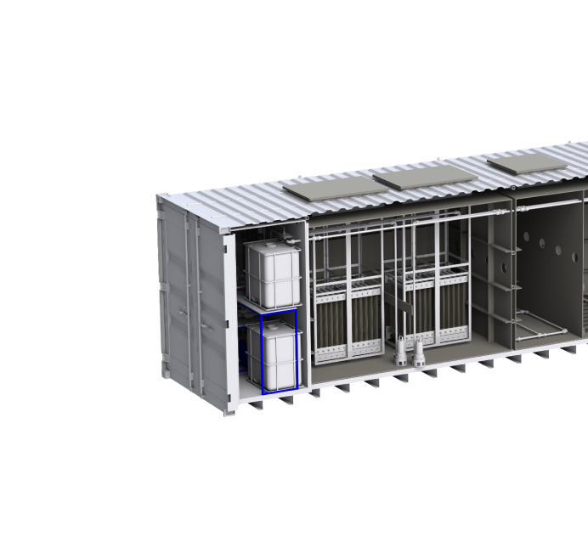

Water solutions for the industrial sector
Energy-Efficient Operation - Minimizing consumption for cost savings, environmental responsibility, and effective water reuse
Long-Term ROI Potential - Demonstrating a compelling average ROI of 3 to 7 years with Spacedrip systems.
Compact Design - Efficiently designed for space optimization without compromising performance.
Containerized system - Containerized systems are easy to transport and deploy.
Predictive maintenance - Stay informed with real-time monitoring features, ensuring optimal system performance and facilitating proactive maintenance when needed
03

Slide 5
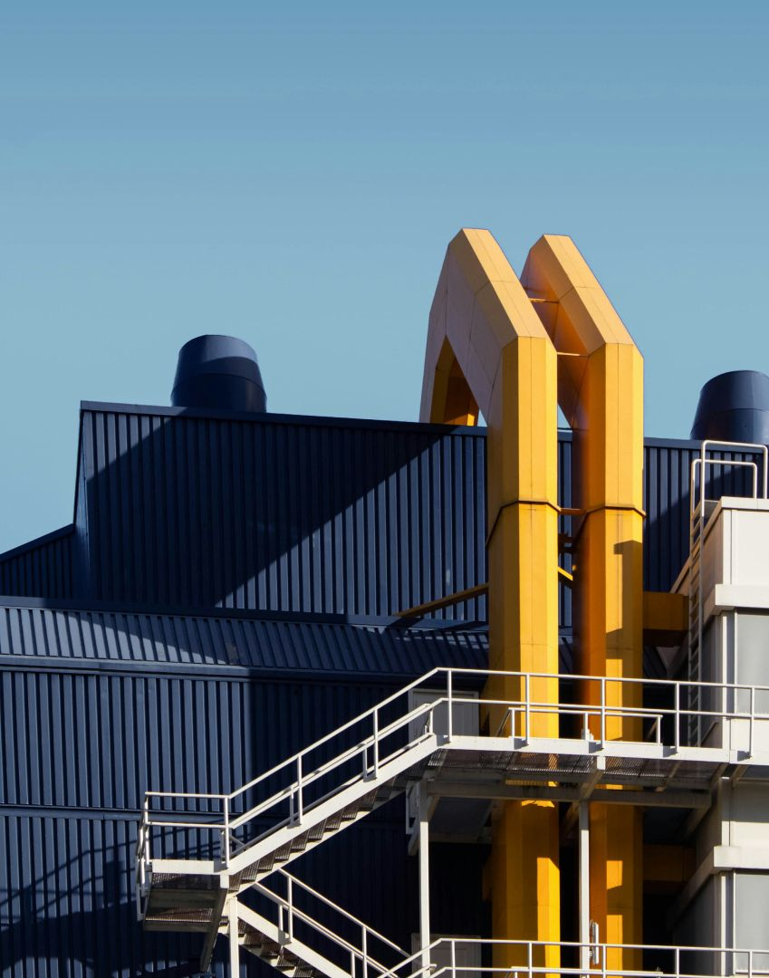
ESG Benefits of Spacedrip Industrial Product Line
Water Risk Management - improved control of water production enables better mitigation of water quantity and quality risks.
Cost Savings - Minimizes costs associated with water procurement, disposal, and energy consumption, offering financial benefits alongside environmental impact
Regulatory Compliance - Ensures adherence to EU water and discharge regulations, preventing potential fines and legal issues
Data Transparency and Quality Standards - Provides detailed monitoring for accurate ESG reporting and maintains high water quality standards, enhancing safety and sustainability credibility
04

Slide 6


Technology
Improved wastewater treatment technology paired with advanced sensors, user-friendly software and automation for more efficient results.
Robotized treatment processes reduce energy demand and maintenance needs by up to 70% compared to traditional wastewater treatment plants.
Our core technology is aerobic membrane bioreactor (MBR). Wastewater is treated with activated sludge, and water is filtered to solid-free permeate with microfiltration membranes with a pore size of 0.2 μm.
An additional automated reverse osmosis module with a disinfection module is used when treated water is reused for potable applications.
The technology is fitted in on-ground or underground tanks and containers by Spacedrip or by Spacedrip's partners.
05

Slide 7
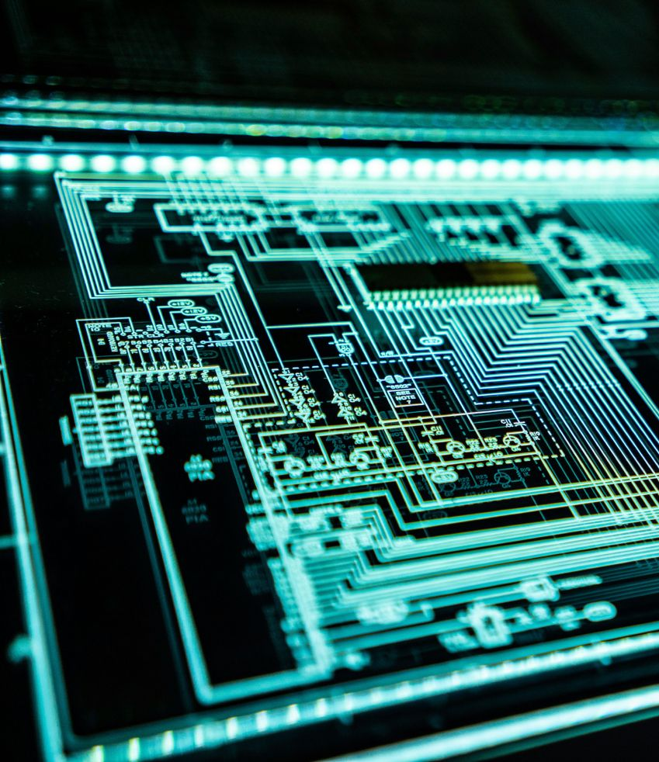
Automation
Biological processes such as activated sludge and membrane control, aeration and nitrogen removal are optimized for best performance.
Automation extends equipment lifespan, reduces maintenance downtime and guarantees high water quality through real-time monitoring.
Immediate notifications for error alerts and maintenance enable predictive maintenance, avoiding long-term high costs.
The system adapts automatically to wastewater inflow fluctuations avoiding human intervention.
06

Slide 8
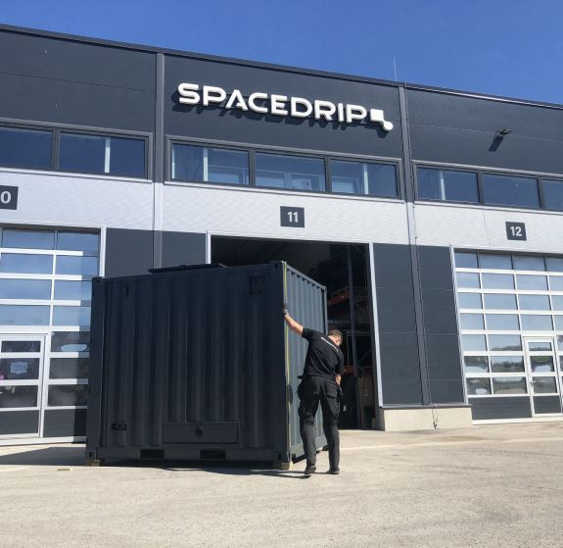

Support
Spacedrip supports its partners throughout the product life-cycle.
Maintenance and operations training is provided for maintenance partners and customers.
Online operating and distance support is available to local maintenance partners.
Depending on system size, 2-5 onsite maintenance visits per year by a local technician are required.
Predictive maintenance is based on software forecasts.
07

Slide 9

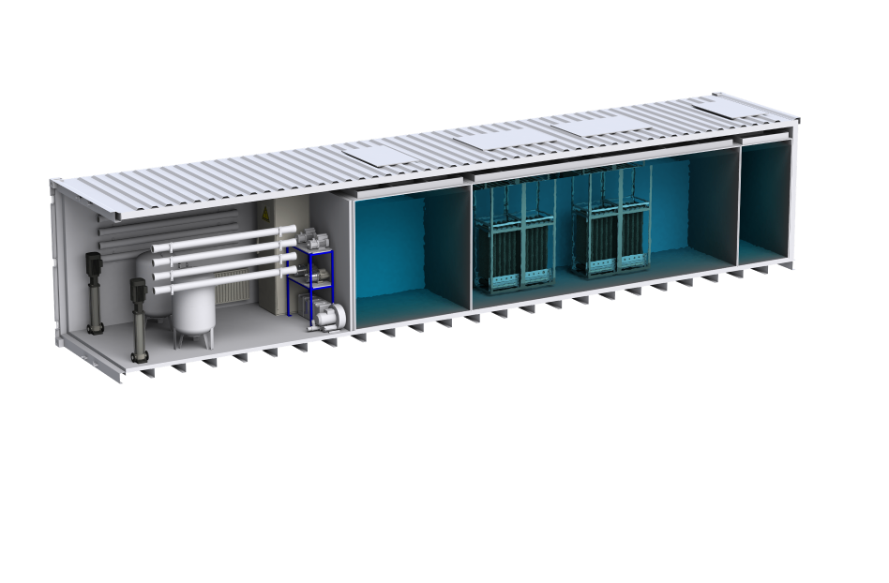

Brewery
02 Use case
The aim is to achieve brewery ESG targets by reducing water consumption
An all-in-one system housed within a 40ft container with MBR and reverse osmosis technology was implemented
Automated process management through advanced sensors and software
Treated water is used for tank cleaning, filter washing, and can rinsing operations.
The system treats and reuses up to 97 cubic meters of wastewater daily
10

Slide 10


Contact
Jan Tomingas
James Parrish
Kimmo Sõna
Head of Sales and Partnerships
Account Manager
Sales Engineer
jan.tomingas@spacedrip.com
james.parrish@spacedrip.com
kimmo.sona@spacedrip.com
+372 5620 3647
+372 5656 7175
+372 5685 0955
@spacedrip
www.spacedrip.com

Slide 11
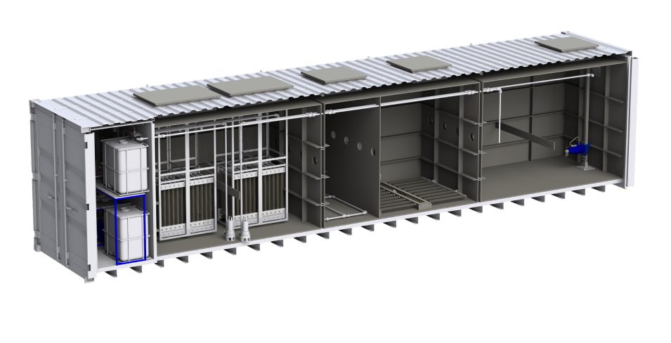

Paper & Pulp Factory
The set up
Implementing a containerized system to treat the paper factory’s wastewater and reuse water for paper edge protectors production.
The first phase of the project is one 40ft containerized MBR system treating and reusing 60 cubic meters of wastewater daily.
A full-scale solution will treat and reuse up to 360 cubic meters of wastewater per day, installed into 6 pcs of 40ft containers.
08

Slide 12
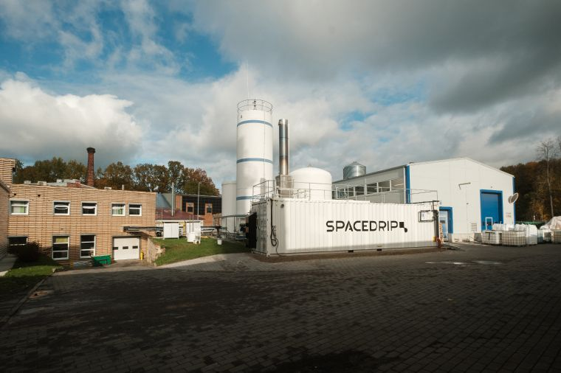
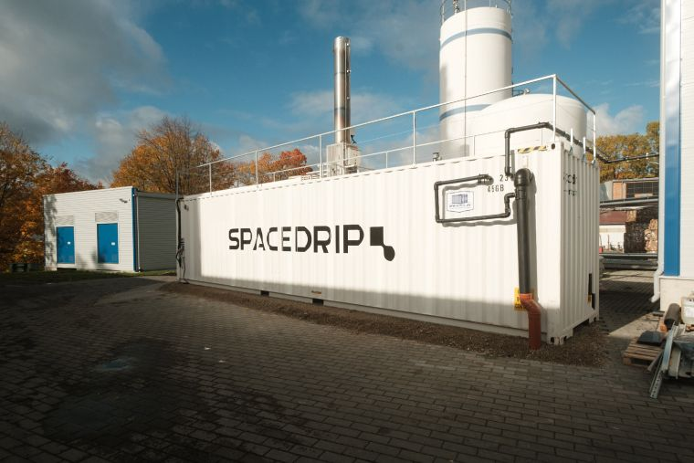
Papermill
09

