Slide 1



Automated wastewater reuse systems
The future is water reuse

Slide 2


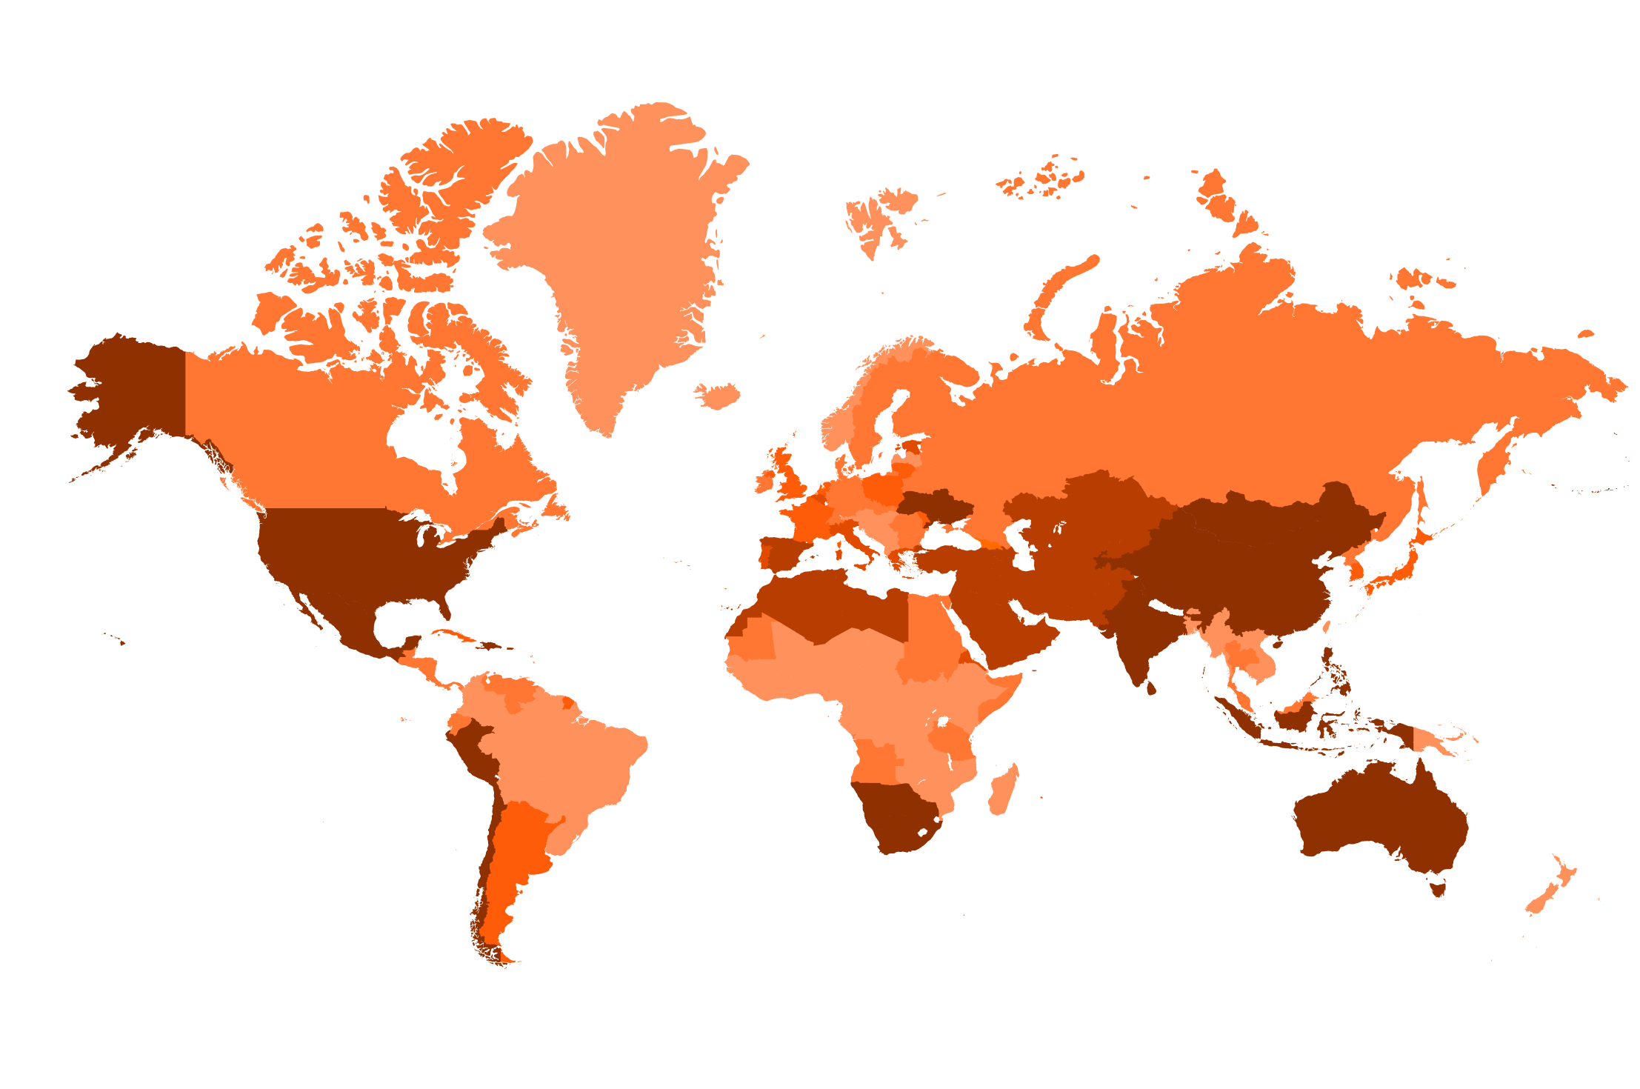



Water Scarcity is
No Longer a Distant Concern
Water stress by country: 2040
NOTE: Projections are based on a business-as-usual scenario using SSP2 and RCP8.5.
Urbanization and climate change are increasing water scarcity.
Fact: By 2030, global water demand is expected to exceed supply by 40%, according to the United Nations.
What if every drop of water could be reused?
Ratio of withdrawals to supply
< 10%
10-20%
20-40%
40-80%
> 80%

Slide 3
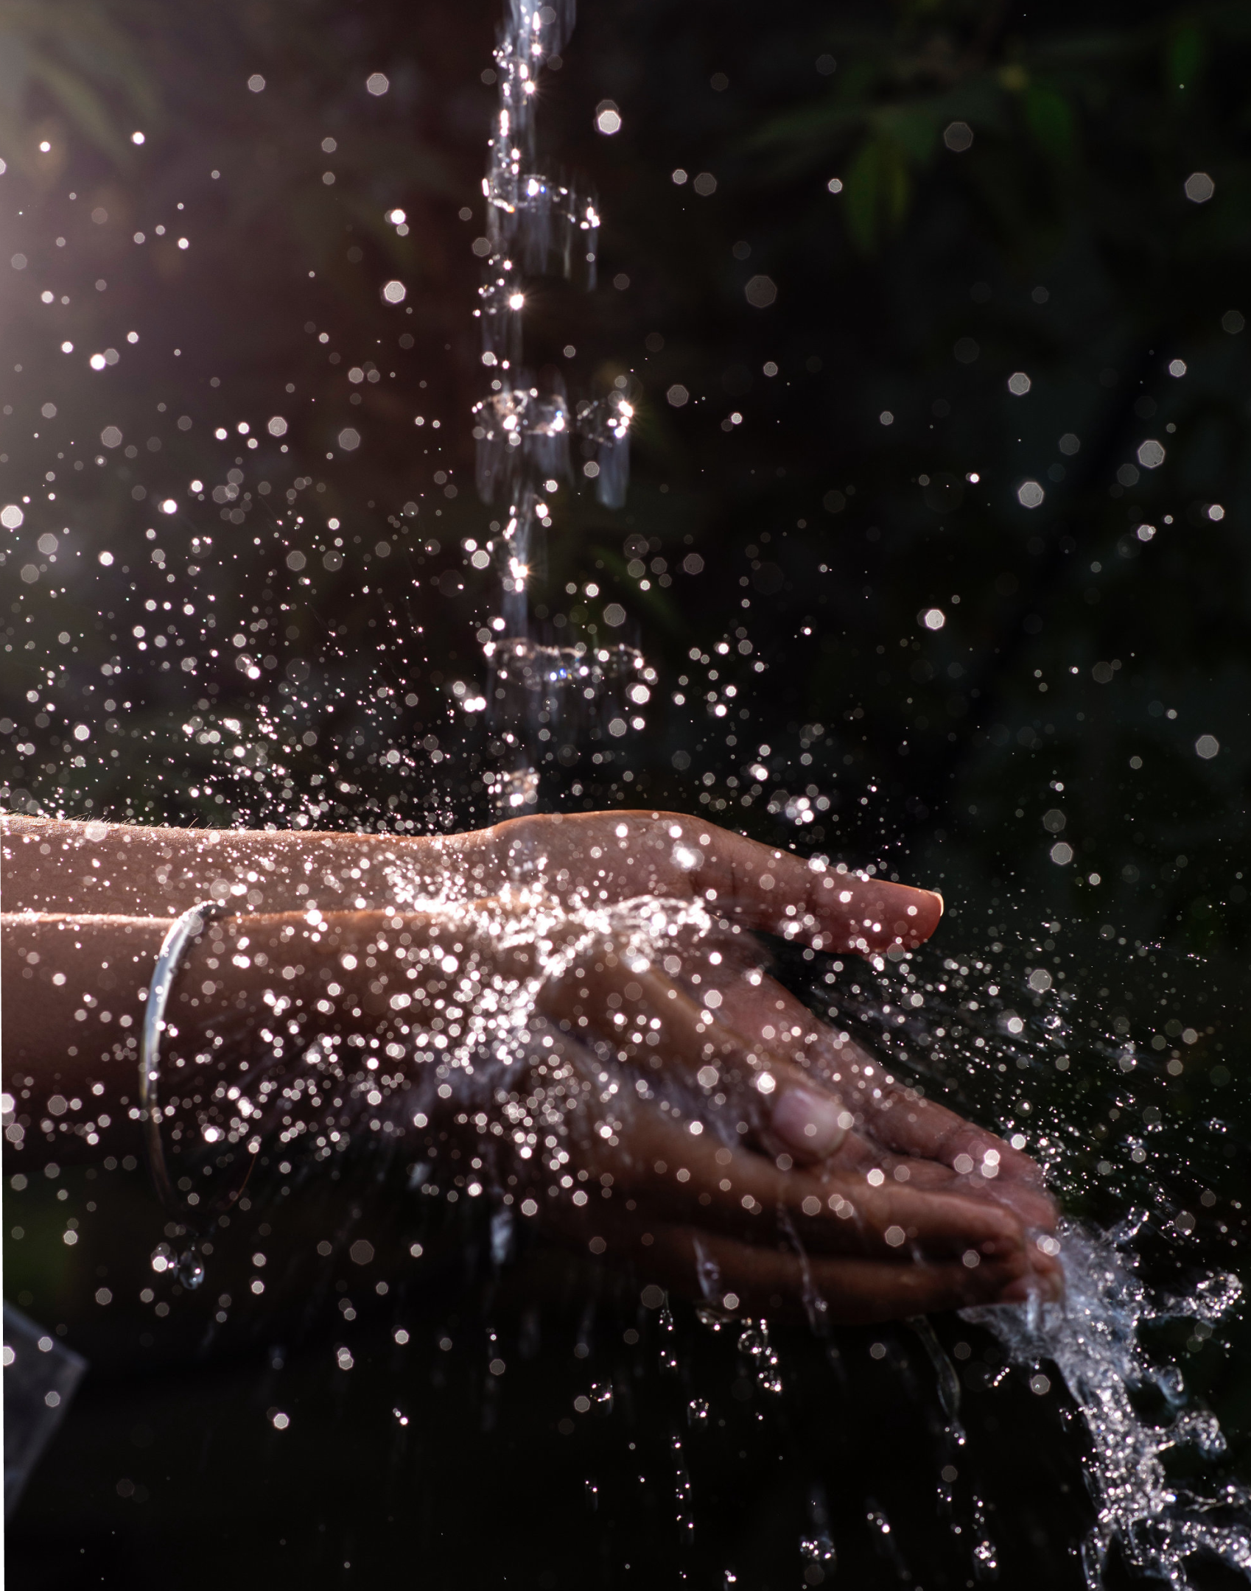

Spacedrip is an Estonian tech company with a vision for a healthy and sustainable use of Earth’s most vital resource — water
The future is water reuse
Founded in 2020 — Spacedrip has developed systems that provide wastewater treatment and water reuse systems for defence, emergency, industrial sectors, and off-grid and urban communities.
Our goal is to build water resilience by decentralizing water management with onsite water reuse

Slide 4

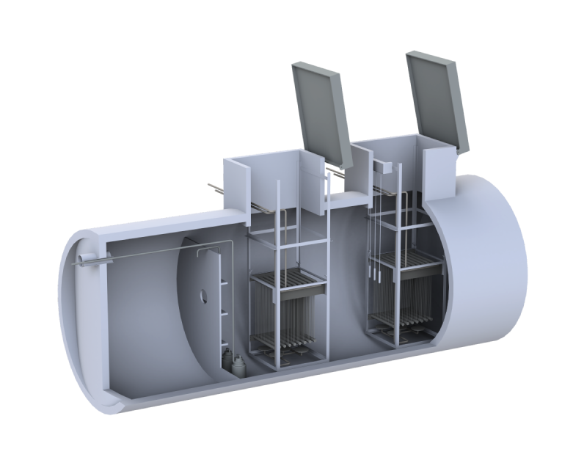
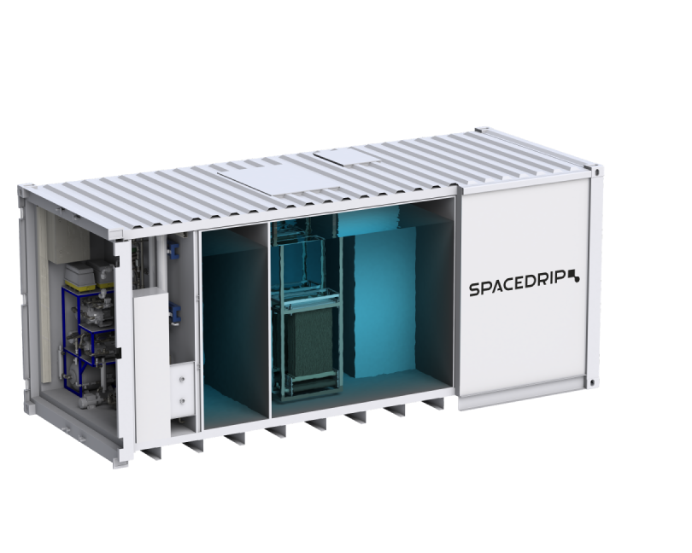
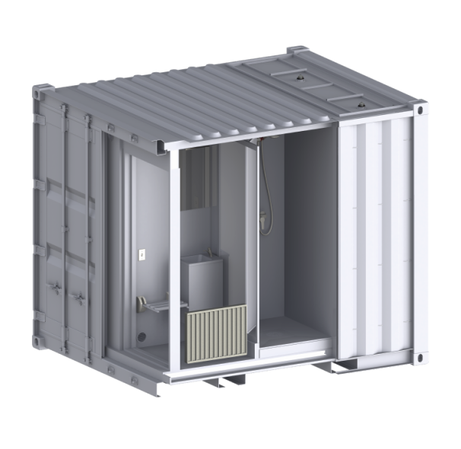

The product lineup of Spacedrip
Rapid
Remote & Modular
Industry & special projects
Closed-loop fully-containerized water reuse systems for providing potable and non-potable water access.
Underground, in-building or containerized systems suitable for real estate developers or utility companies that need to provide water and sewer access in remote or water-stressed communities. Water reuse as non-potable or potable water.
Containerized and in-building systems for industries with non-toxic water-heavy processes with water reuse on non-potable or potable quality level.

Slide 5

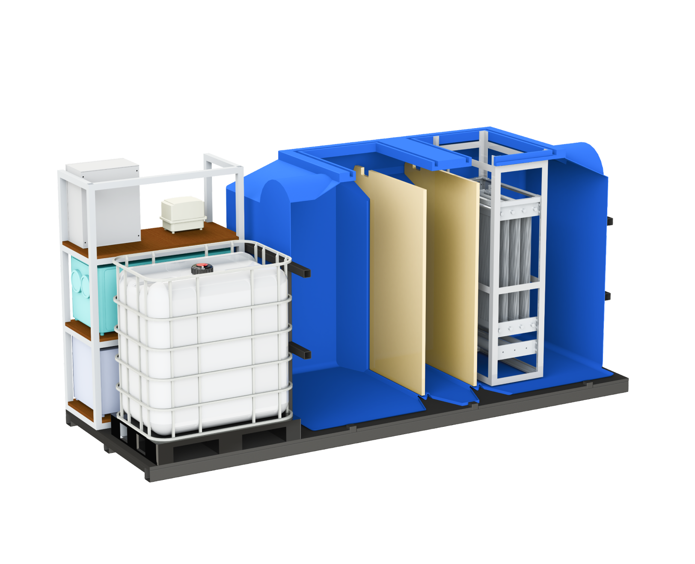

Innovative Water Solutions
The future is water reuse
Shippable containers - a budget-friendly solution by minimizing civil engineering expenses associated with traditional construction methods.
Option to rent mobile containerized systems - flexibility to rent mobile containerized systems, providing a water treatment solution that meets specific needs without the commitment of ownership.
Plug & Play system - plug-and-play design ensures seamless installation and operation, minimizing disruption to existing infrastructure
Water as a Service - a unique subscription-based model, providing access to high-quality water treatment solutions without upfront investment

Slide 6
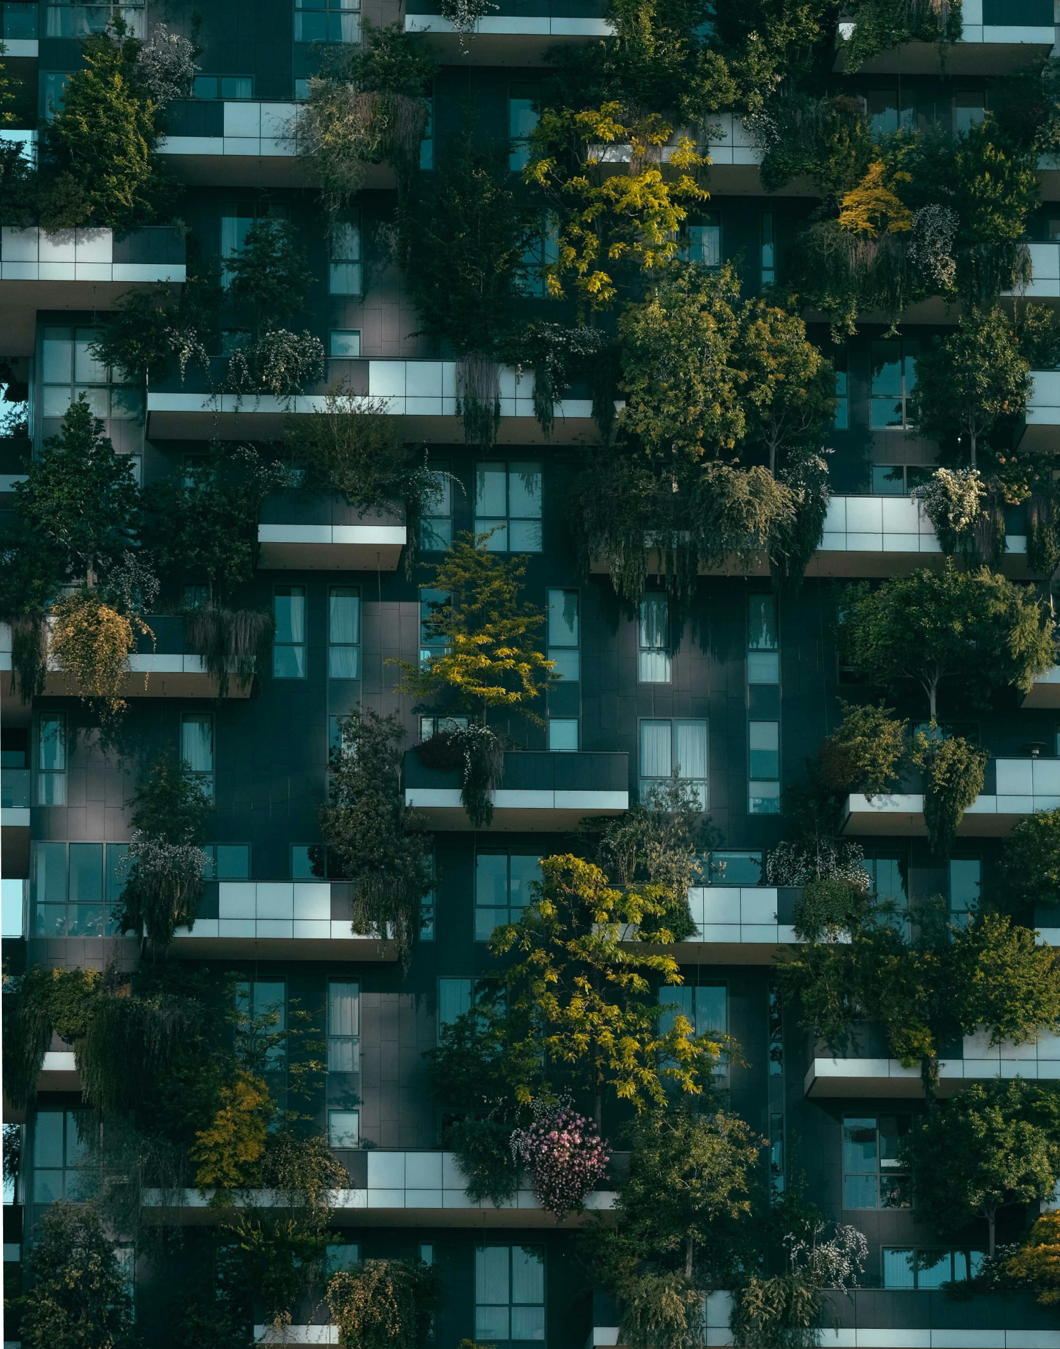
Sustainability
The future is water reuse
Spacedrip reduces water consumption by up to 70%. That’s a huge saving, especially when you consider how the cost of water is rising across France
Enables eligibility for green certifications like BREEAM/LEEDS (and others), for preferential terms and incentives for sustainable investments.
Energy-efficient systems with up to 70% reduced power consumption
Long-term cost savings through low operational expenses and reduced maintenance.
Eliminate financial risks such as fines, and penalties, through reliable treatment performance and adherence to strict regulatory compliance

Slide 7

Technology
The future is water reuse
Improved wastewater treatment technology paired with advanced sensors, user-friendly software and automation for more efficient results.
Our core technology is aerobic membrane bioreactor (MBR). Wastewater is treated with activated sludge, and water is filtered to solid-free permeate with microfiltration membranes with a pore size of 0.2 μm.
An additional automated reverse osmosis module with a disinfection module is used when treated water is reused for potable applications.
Technologies are fitted in on-ground or underground tanks and containers by Spacedrip or by Spacedrip's partners.

Slide 8

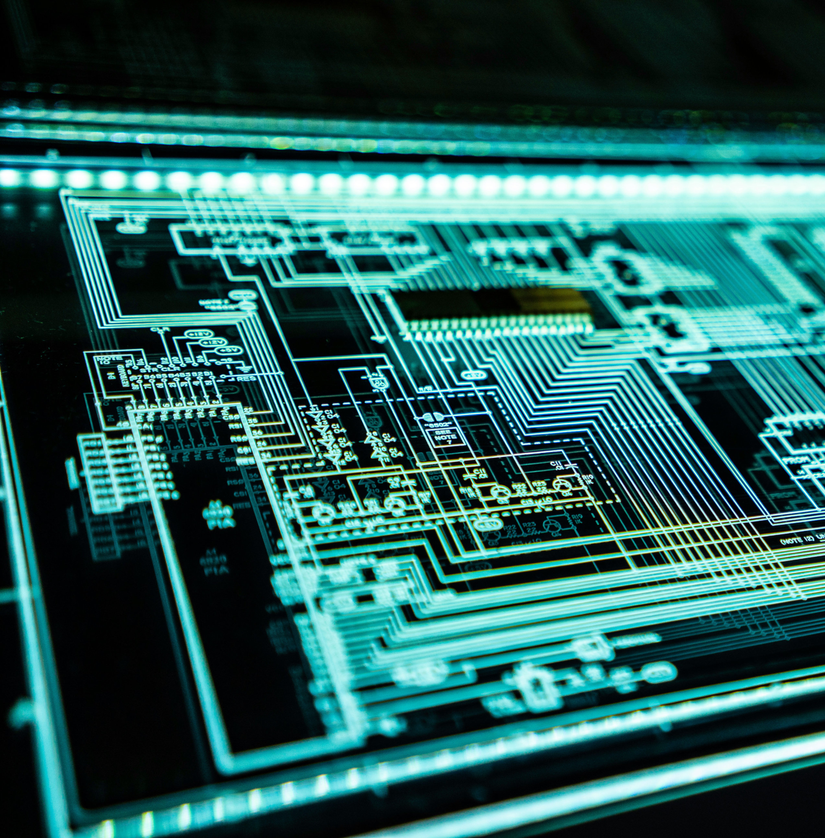
Automation
The future is water reuse
Biological processes such as activated sludge and membrane control, aeration and nitrogen removal are optimized for best performance.
Automation extends equipment lifespan, reduces maintenance downtime and guarantees high water quality through real-time monitoring.
Immediate notifications for error alerts and maintenance enable predictive maintenance, avoiding long-term high costs.
The system adapts automatically to wastewater inflow fluctuations avoiding human intervention.

Slide 9










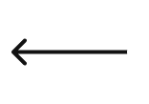
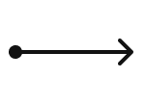
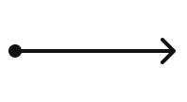










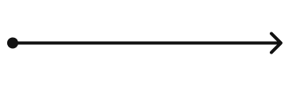
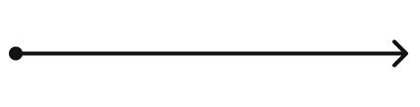


Technology
Quality control system
Water reuse
Software
Control
panel
Remote monitoring
Reverse
osmosis
Wastewater
Disinfection
Membrane bioreactor
Mechanical treatment
Anoxic
Aerobic
Non-potable water
Potable water

Slide 10







Contact
Jan Tomingas
James Parrish
Kimmo Sõna
Head of Sales and Partnerships
Account Manager
Sales Engineer
jan.tomingas@spacedrip.com
james.parrish@spacedrip.com
kimmo.sona@spacedrip.com
+372 5620 3647
+372 5656 7175
+372 5685 0955
@spacedrip
www.spacedrip.com

