Slide 1
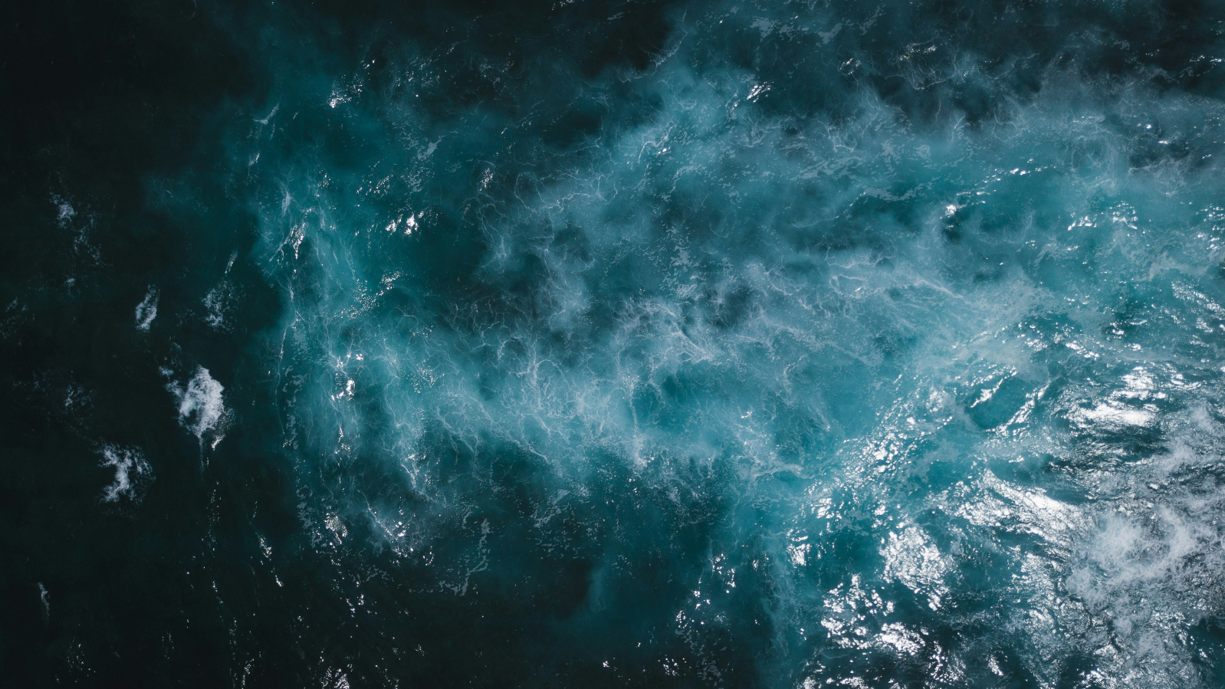


Case studies
The future is water reuse

Slide 2


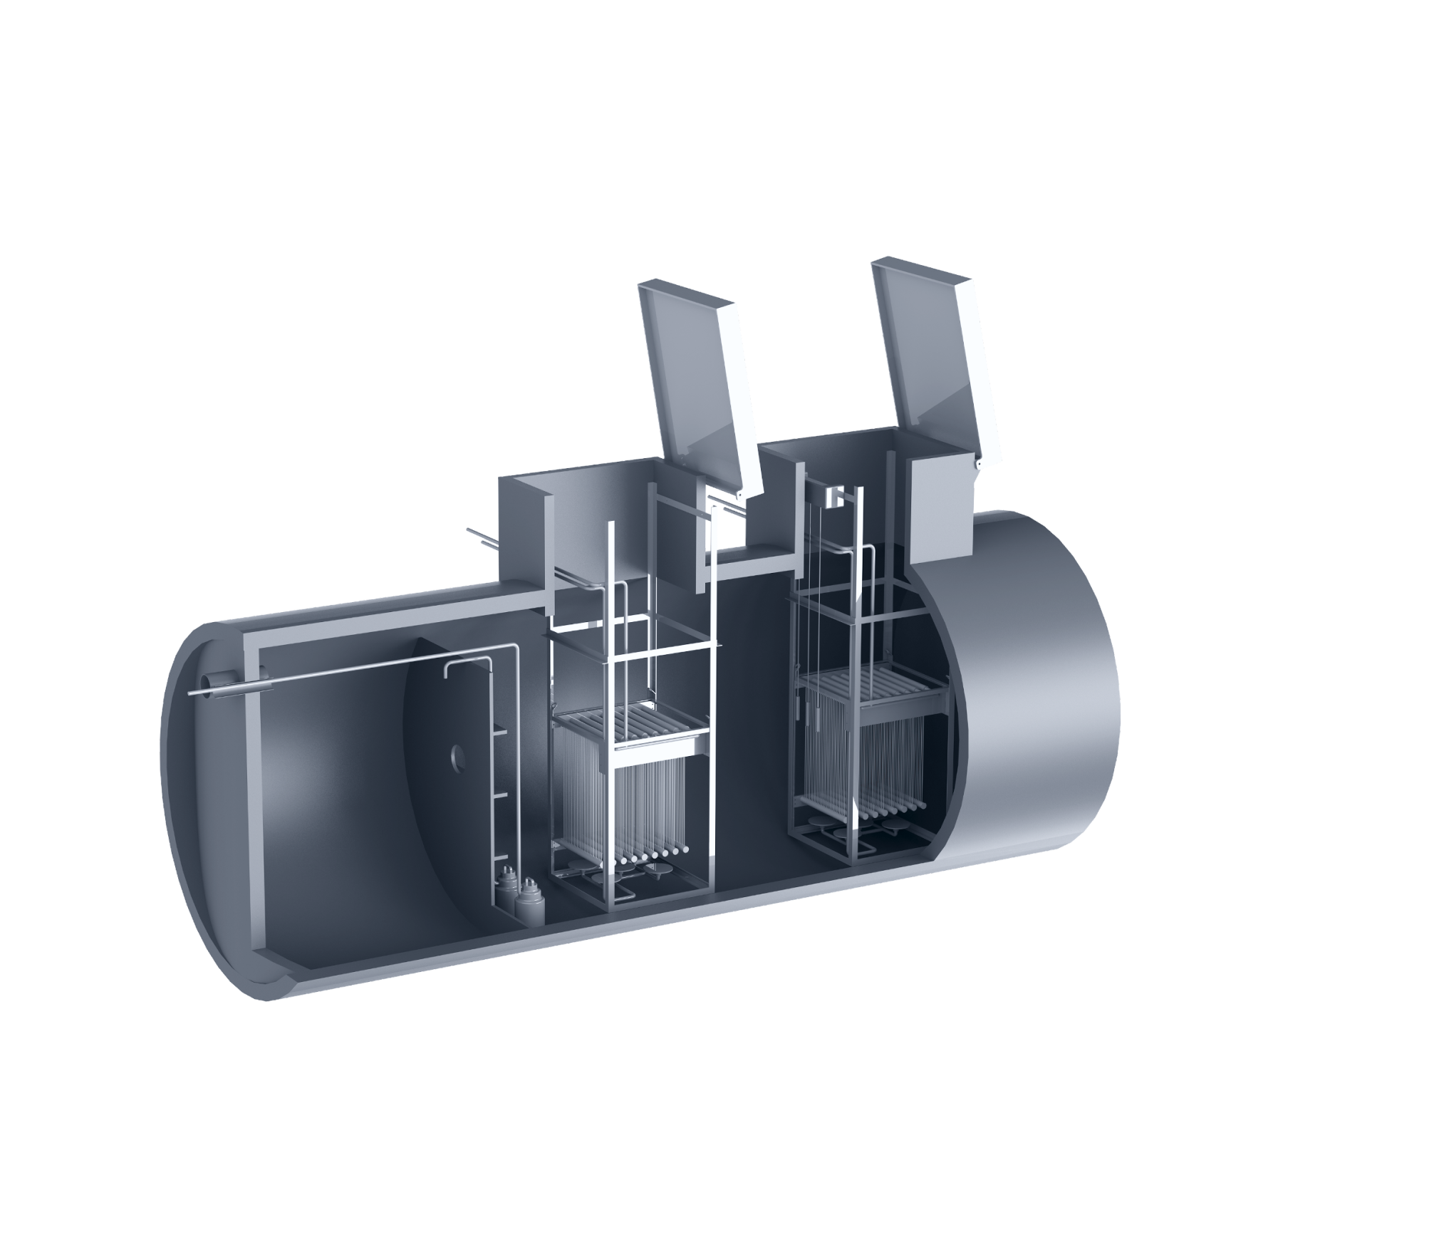


Adila Resort
The set up
Adila Retreat Center is entirely off the grid and located in a delicate nature preserve
with highly seasonal wastewater generation.
Underground wastewater treatment and reuse system for <15m³/day
Resort with daily wastewater volumes changing for up to 15m³/day
Effluent reuse for irrigation/discharge in a resort in a natural reserve
The system is operated and maintained by Spacedrip
01

Slide 3
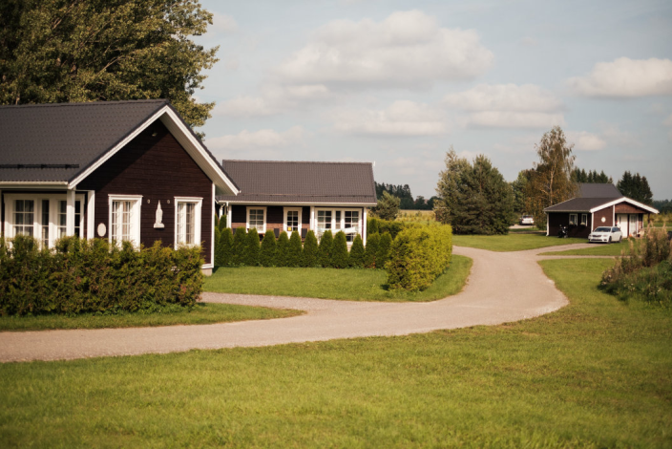
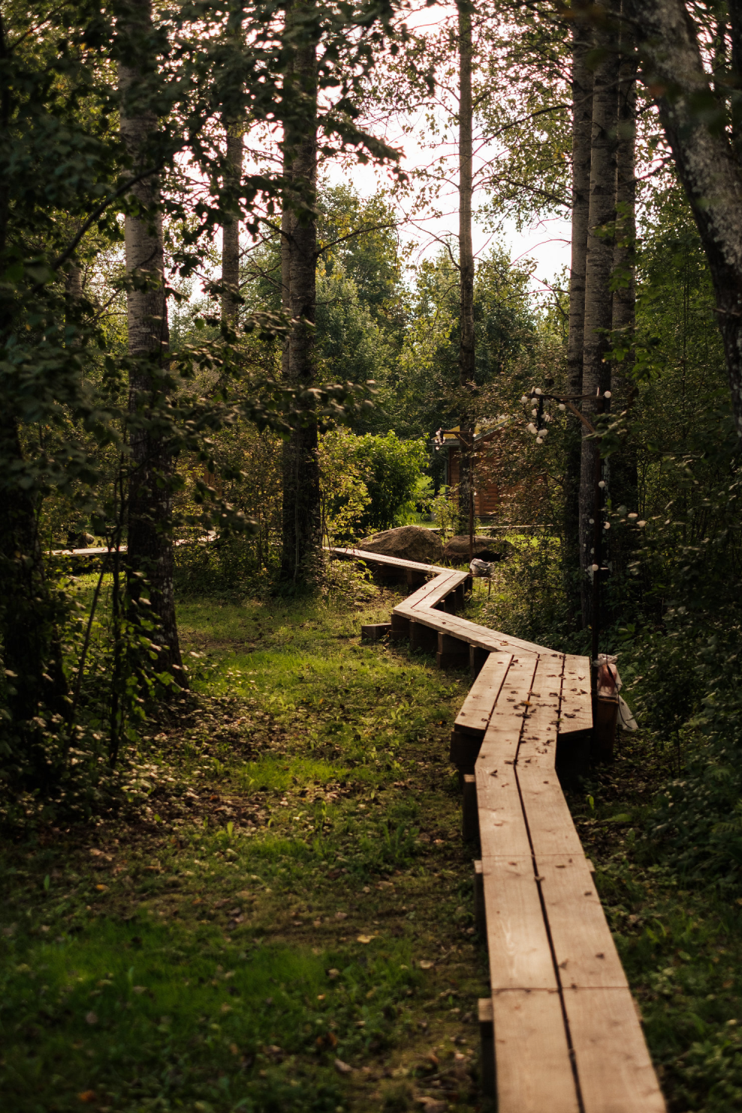
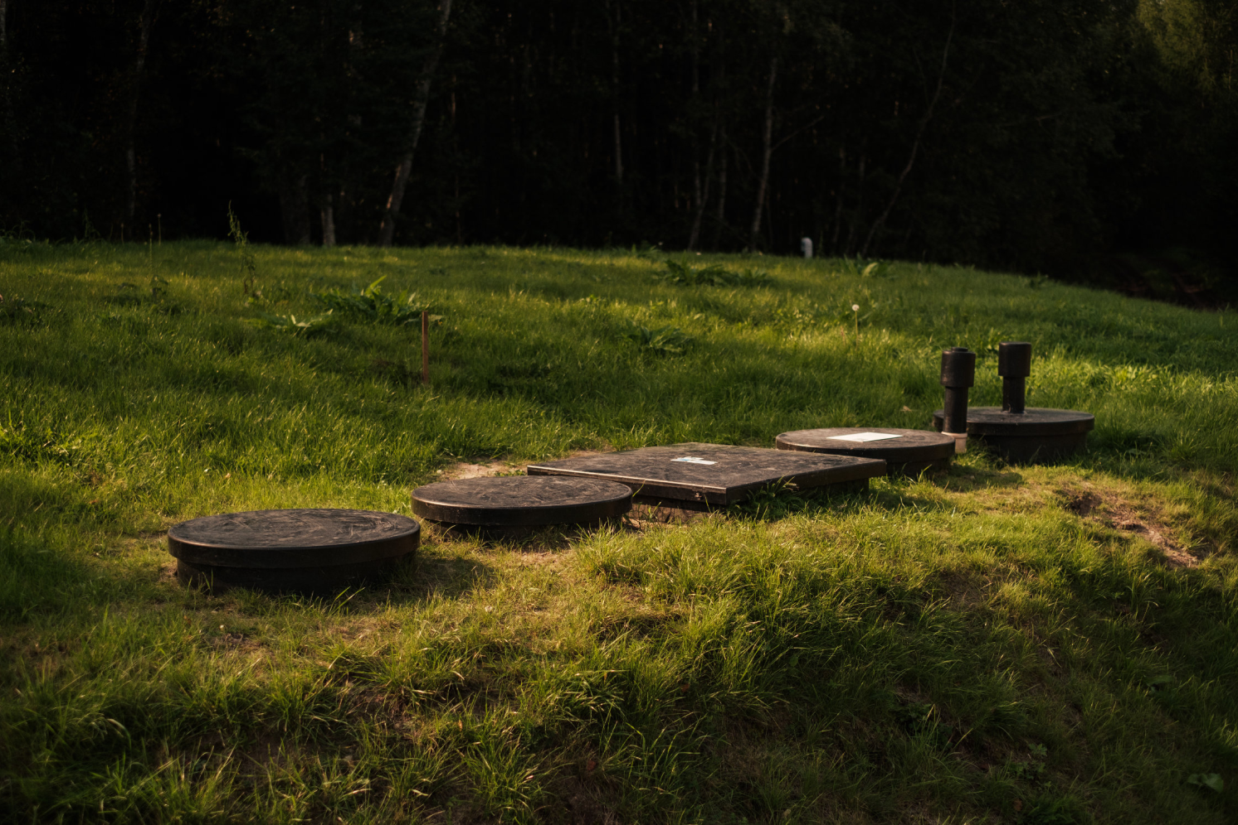
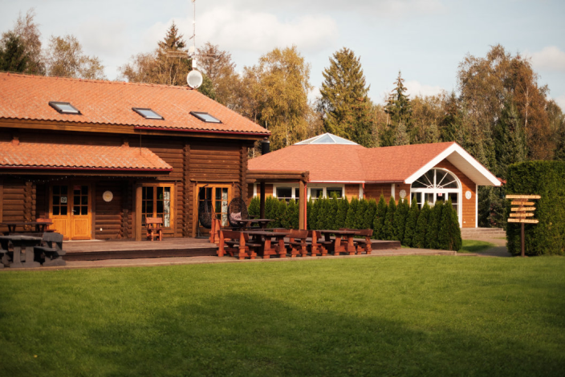
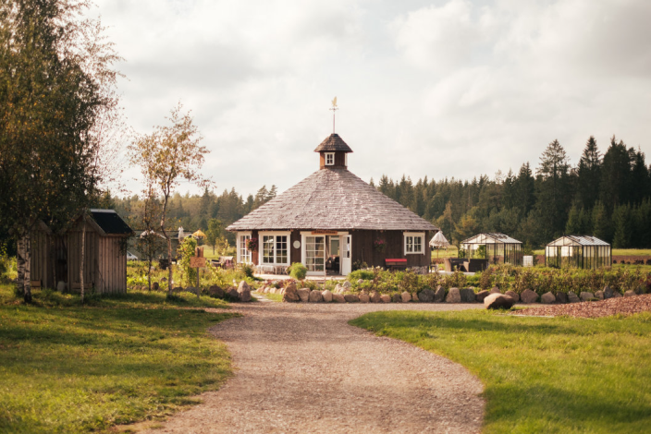


Adila Resort
02

Slide 4

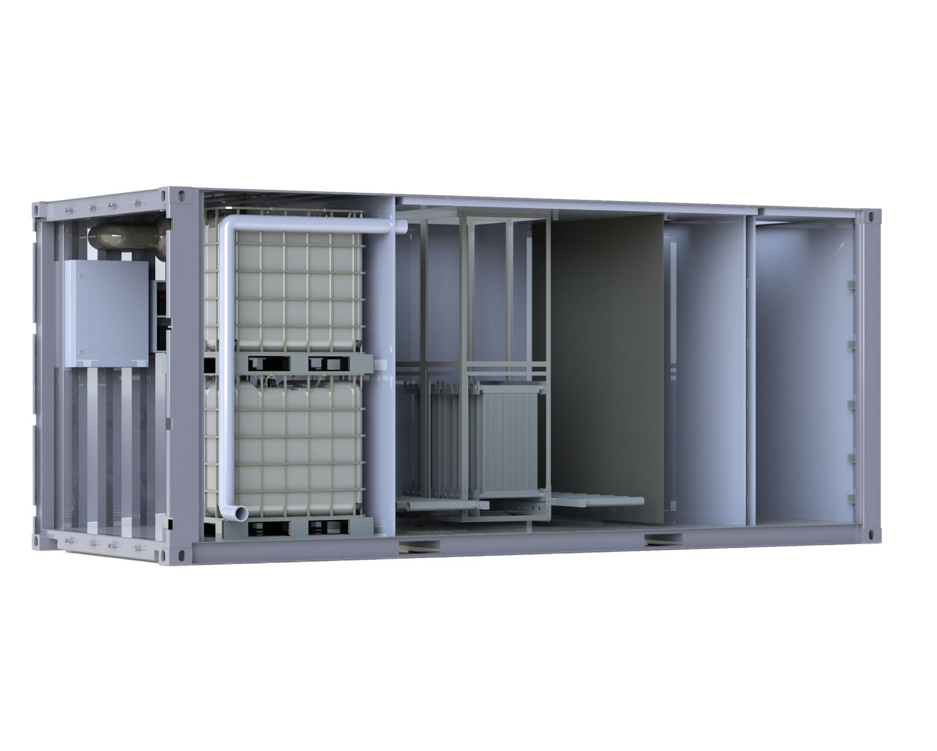

Uhuru Park
The set up
Inadequate wastewater treatment infrastructure in Nairobi leads to water pollution and health hazards, worsening the city's growing water scarcity issues
The all-in-one system is fitted into a 20ft container
Public sewage is treated for reuse for park irrigation, cutting the total water supply
The system treats up to 50m³ of wastewater and cuts 30% of the irrigation needs of a 13-hectare park
Partly powered by solar energy
03

Slide 5
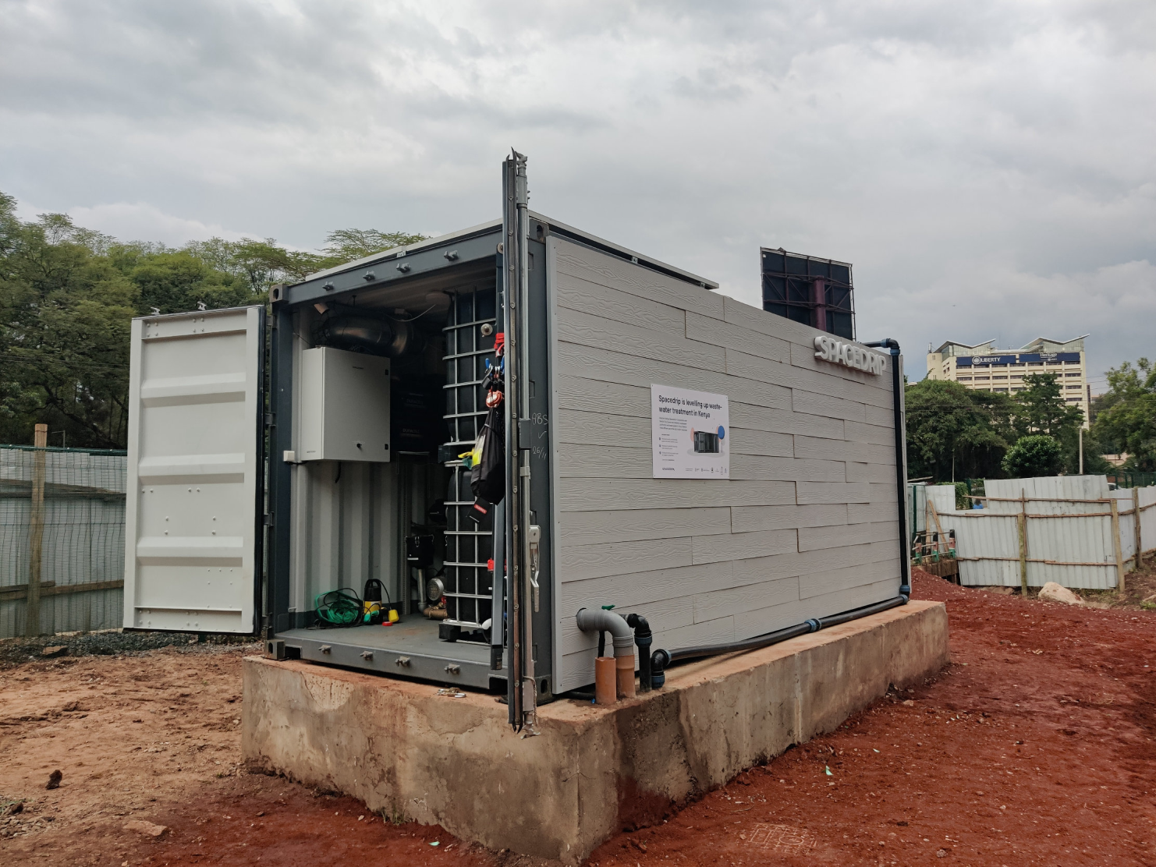
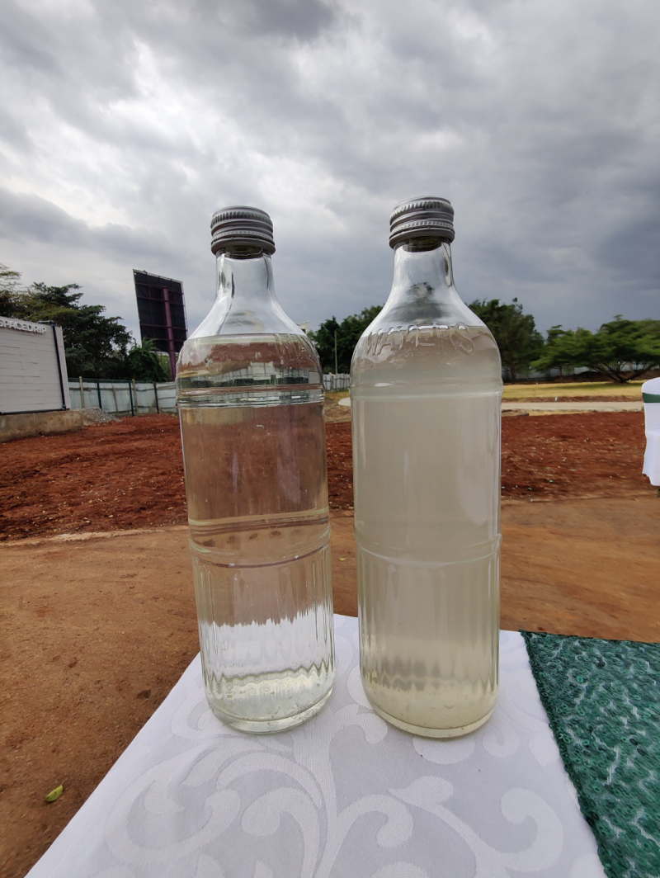
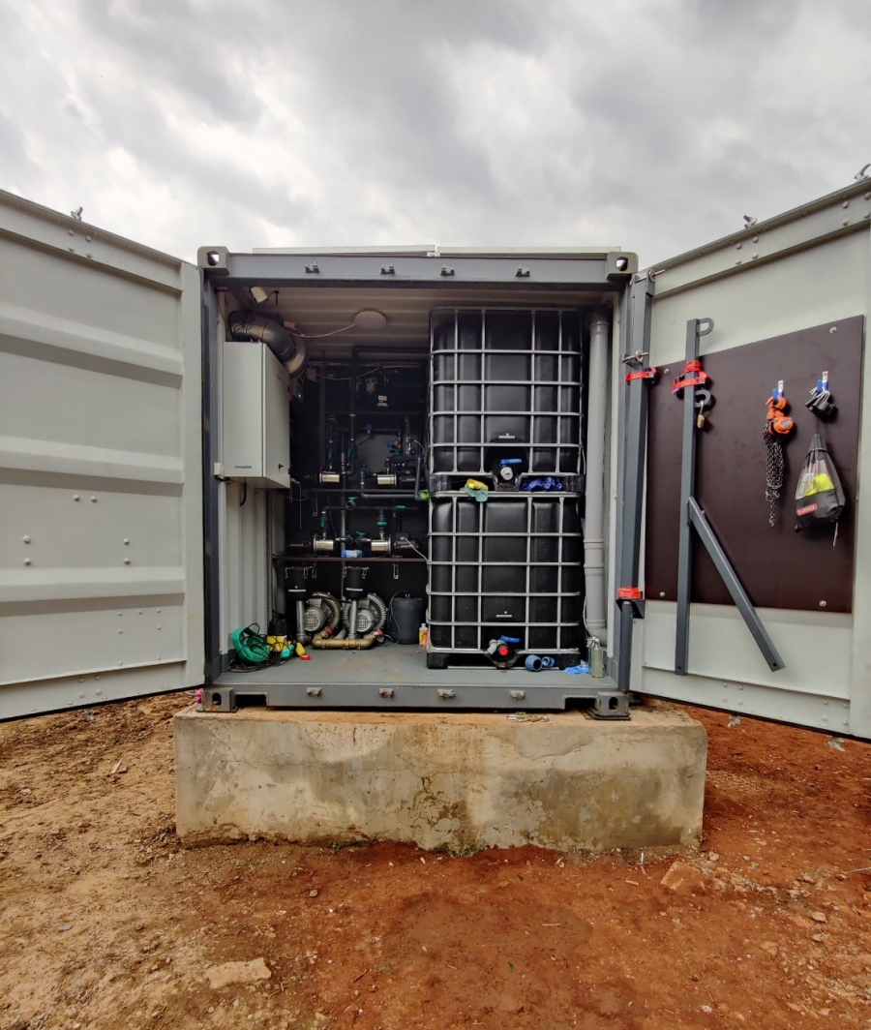
Uhuru Park, Nairobi
04

Slide 6

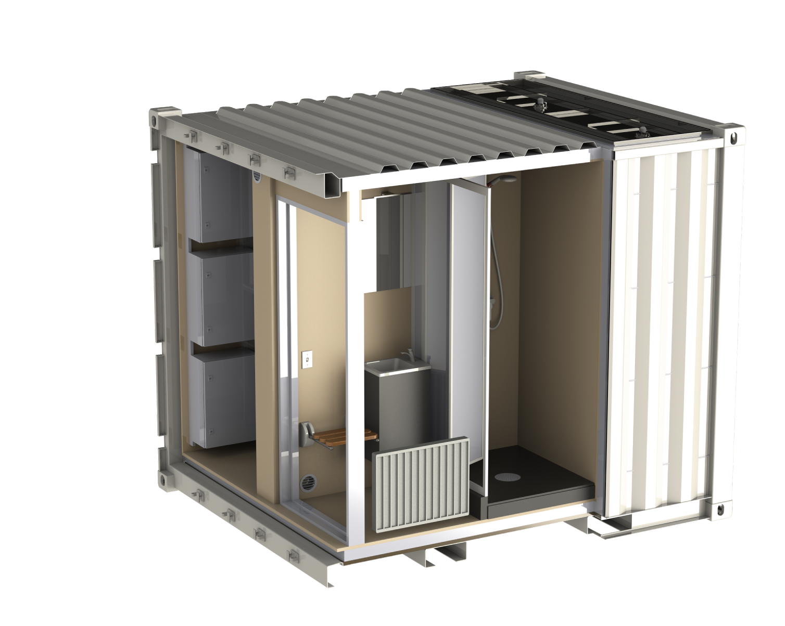
U.S. Army
The set up
Defence forces face increasing costs and logistical difficulties in supplying water to expeditionary forces in off-grid and hostile environments.
Mobile closed-loop water reuse systems for exercises and expeditionary deployments
Up to 1.3m³ of greywater is reused ina day for showers, tap water, and laundry in closed-loop. Wastewater is reused for toilet flushing in a loop
U.S. Army ordered 2 Spacedrip ATWRS systems in 2023. The systems were commissioned during the African Lion 2023 exercise in Morocco. Follow-up contracts in progress.
05

Slide 7
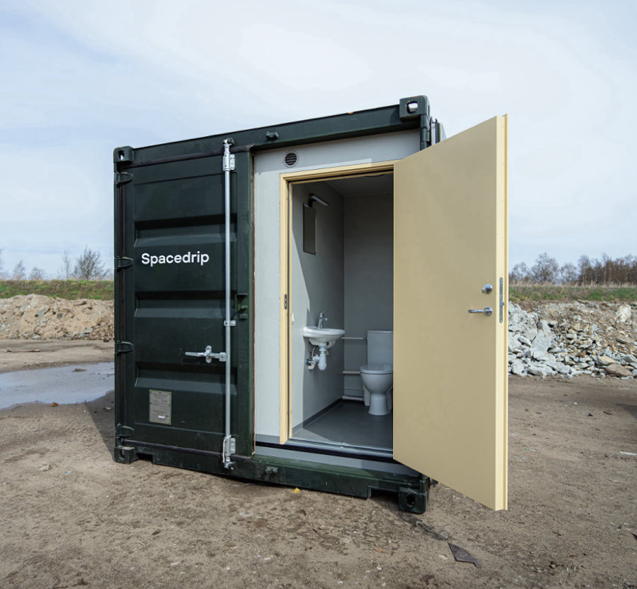
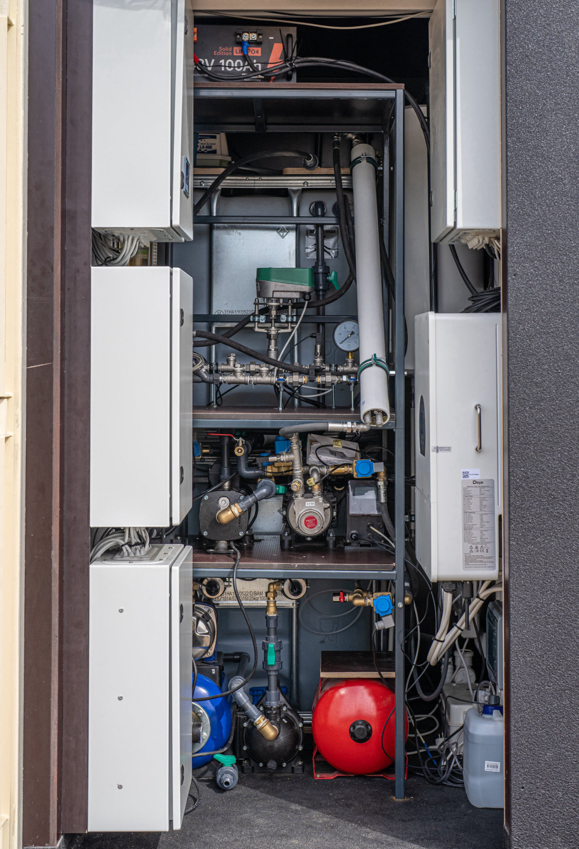
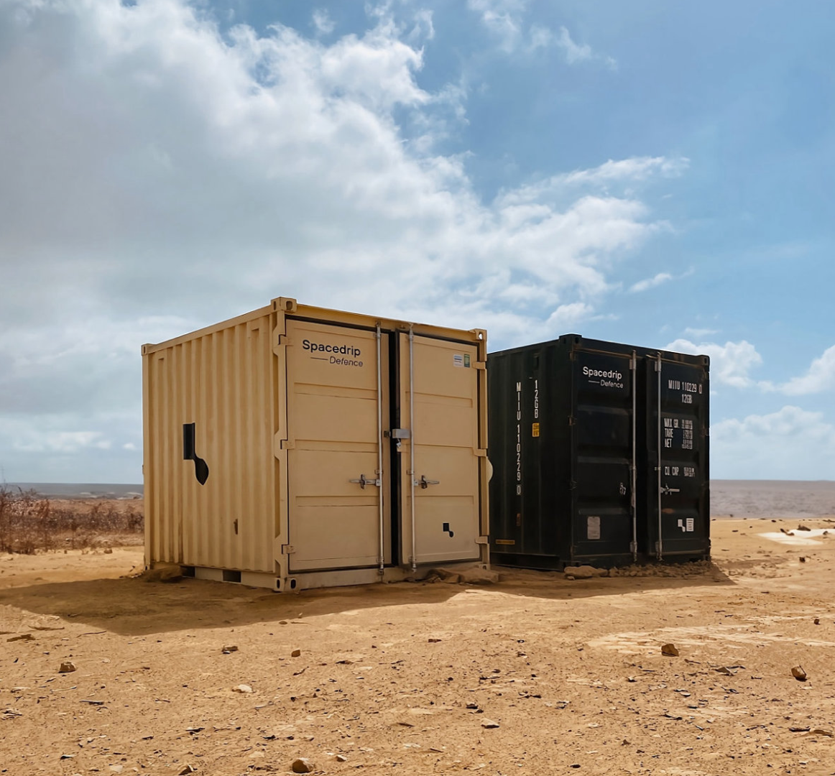
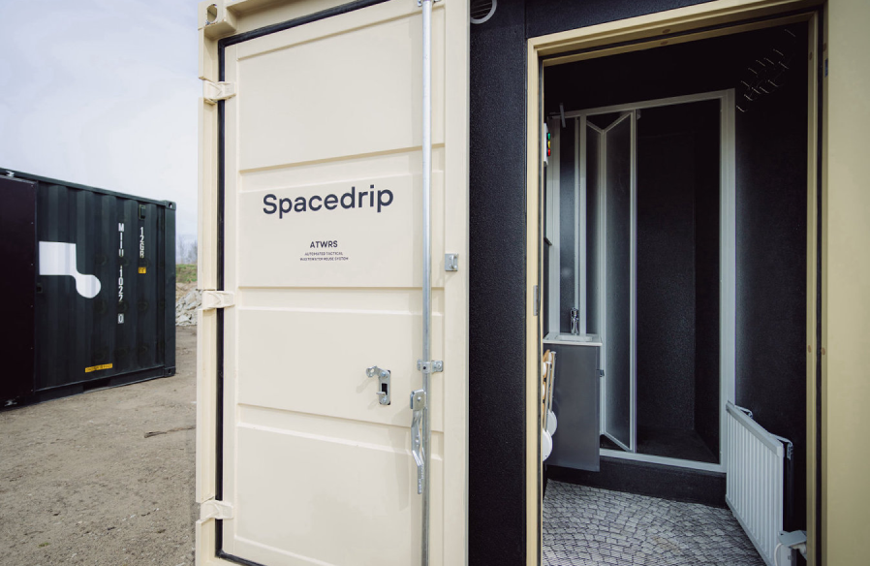
U.S. Army
06

Slide 8

GDS
The set up
Rapidly deployable closed-loop containerized system delivered to Global Defence Solutions in Australia.
Integrated membrane bioreactor, reverse osmosis, UV, and chlorination for optimal potable water.
A compact solution housed in a 10-foot sea container, the system treats 1500 liters of wastewater daily
Engineered for -25°C to 45°C
With daily power consumption of 25 kWh, momentary max power consumption of 15 kW, and weighing 2800 kg
07

Slide 9
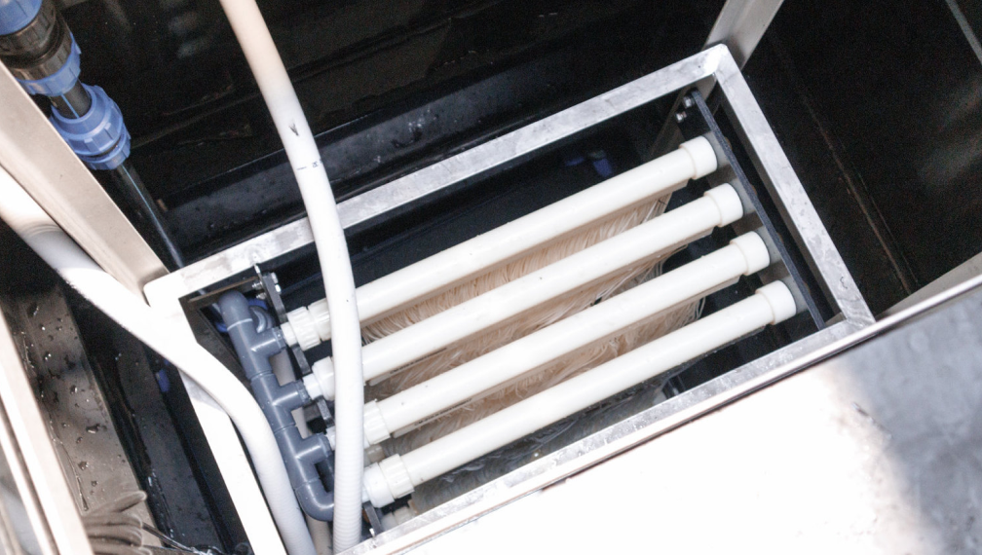
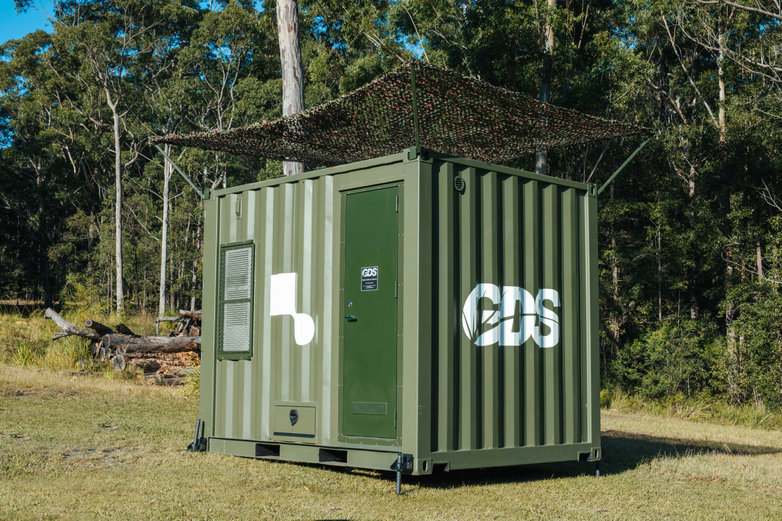
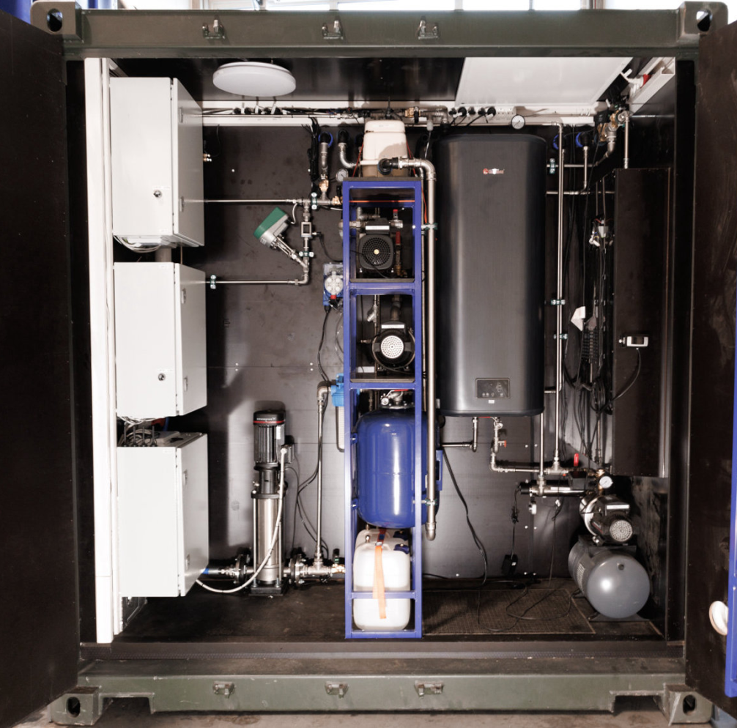
GDS
08

Slide 10
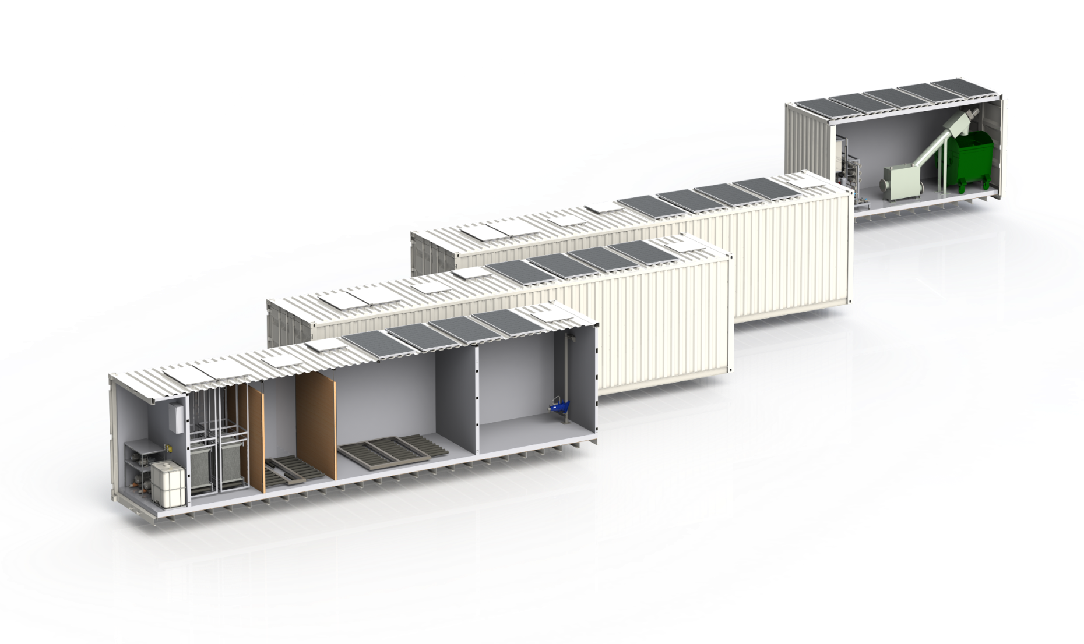

Jägala Estate
The set up
Spacedrip addresses wastewater challenges in a new housing development of 1200 people
Modular 40-foot containerized systems equipped with automation and sensors
Treated water can be reused for non-potable and potable applications.
The system treats and reuses up to 120m³ of wastewater daily, producing 9m³ of potable water.
Power consumption of 240 kWh/day
09

Slide 11
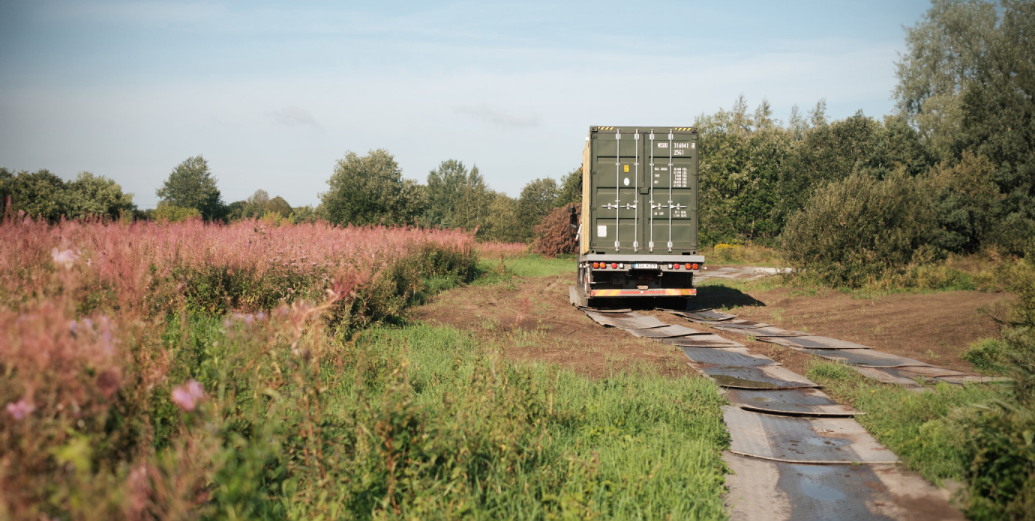
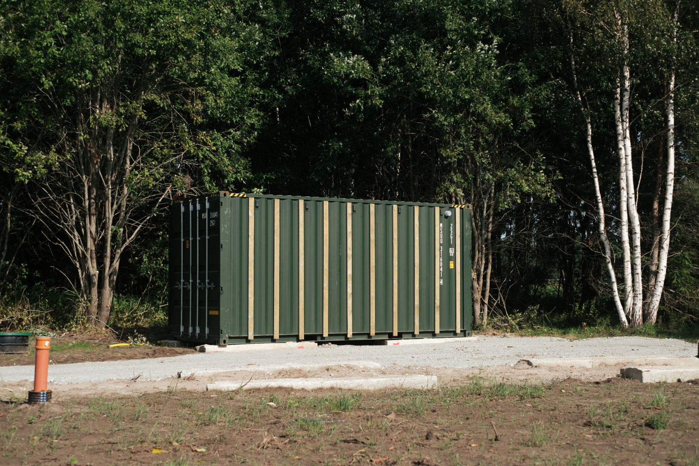
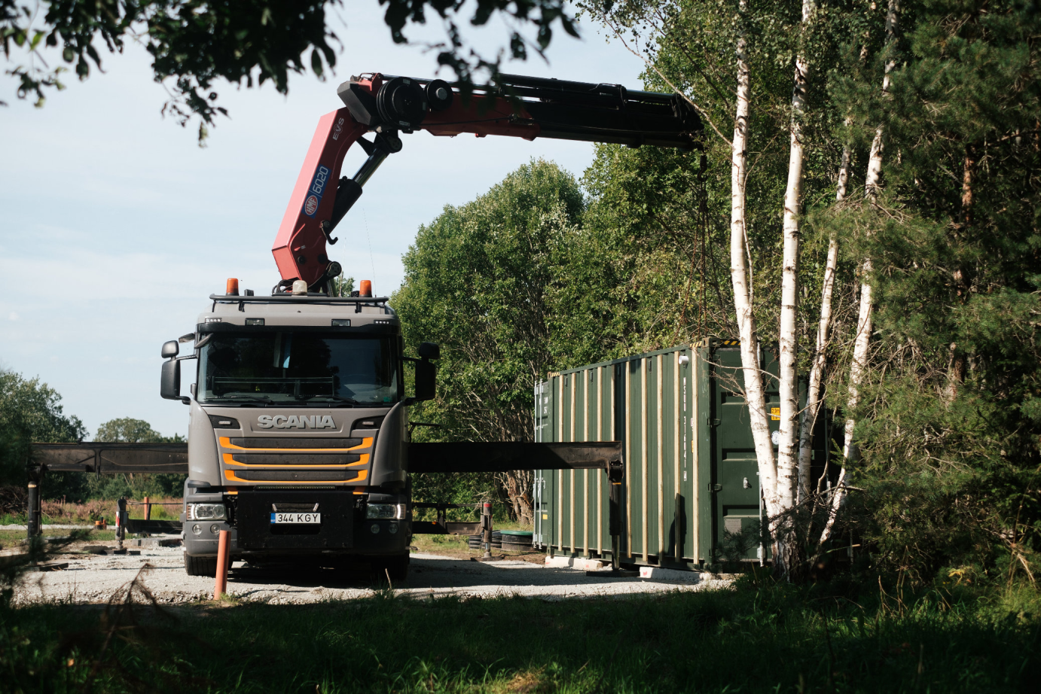
Jägala Estate
10

Slide 12

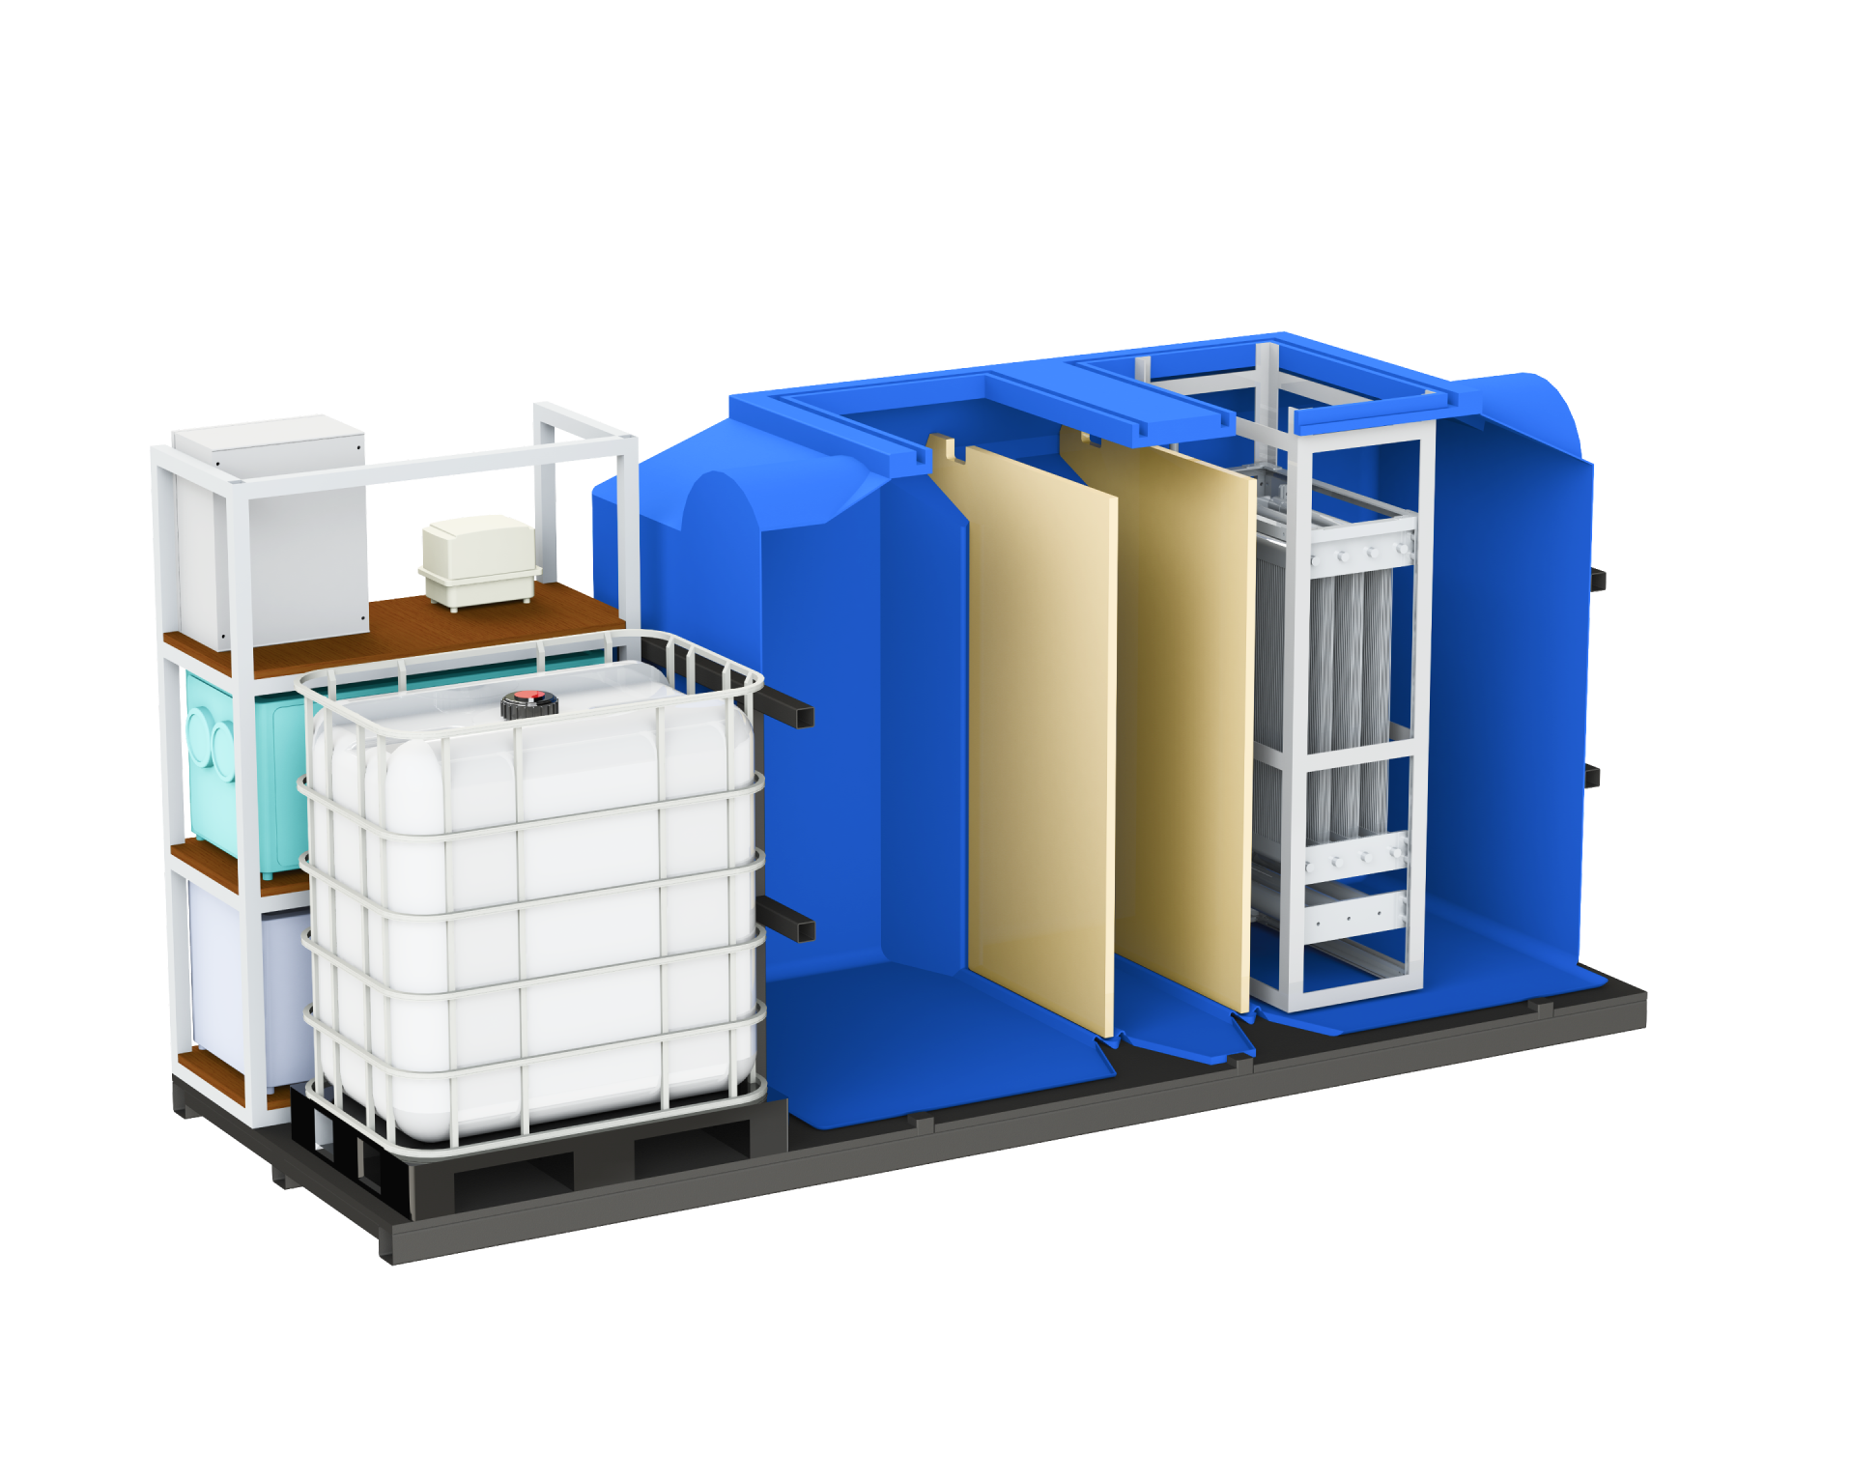

Loo Pilot
The set up
Water circulation pilot project. Completely off the grid closed-loop system that circulates water in the office for 50 people
Treated wastewater is reused as non-potable water for toilet flushing, and potable water for drinking, dishwashing, etc
System volume: 4.3 m³ bioreactor + 1 m³ non-potable buffer tank + 1 m³ potable buffer tank
Energy consumption ranges from 1.9 to 5.6 kWh/m³
11

Slide 13

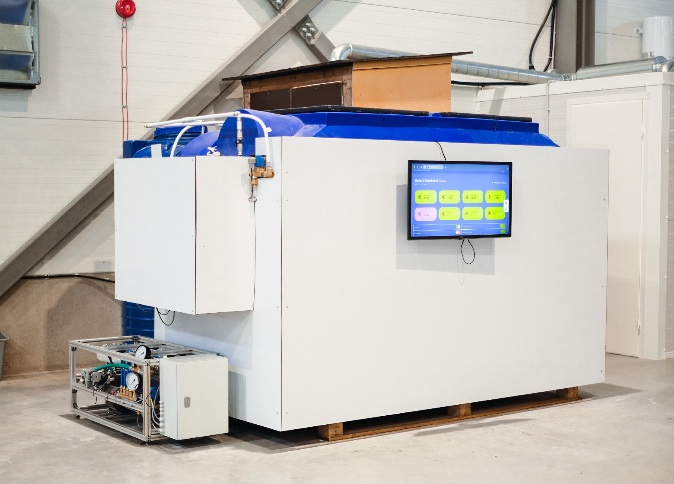

Loo Pilot
12

Slide 14
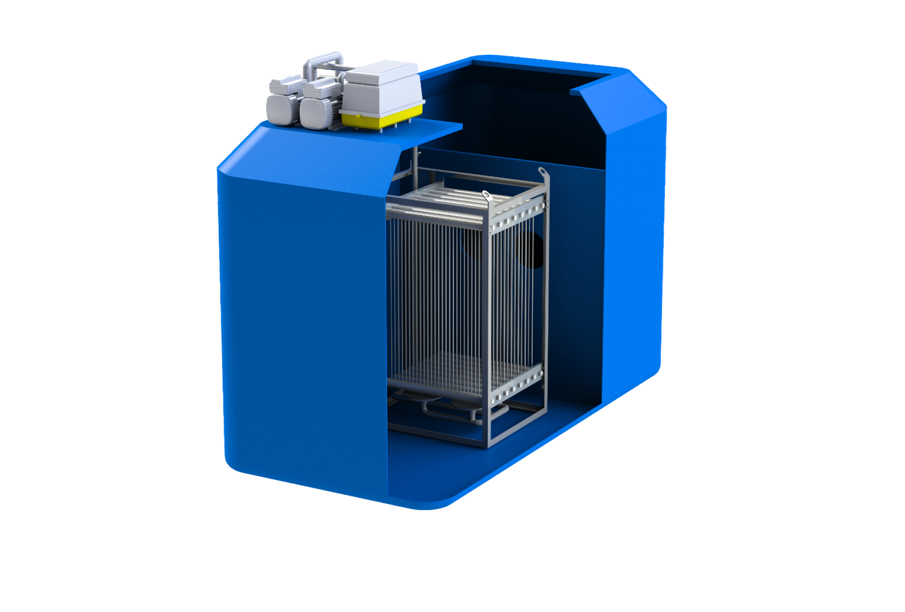
Circle K
The set up
The gas station had sedimentation tanks that needed weekly emptying. The customer wanted to eliminate these costs by replacing them with a wastewater treatment plant.
The system is a compact, automated wastewater treatment system using membrane bioreactor technology, handling up to 5m³/day.
The system includes mechanical treatment with a sedimentation tank, biological treatment with a membrane bioreactor, and an infiltration field for discharging microfiltered wastewater.
13

Slide 15

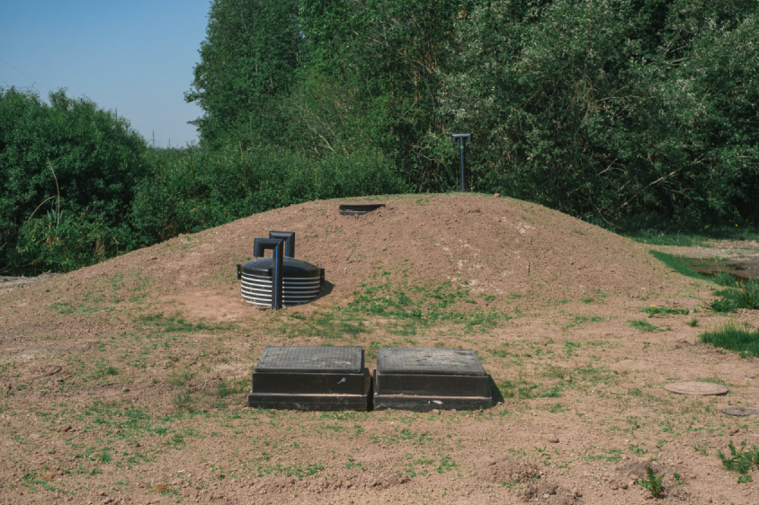
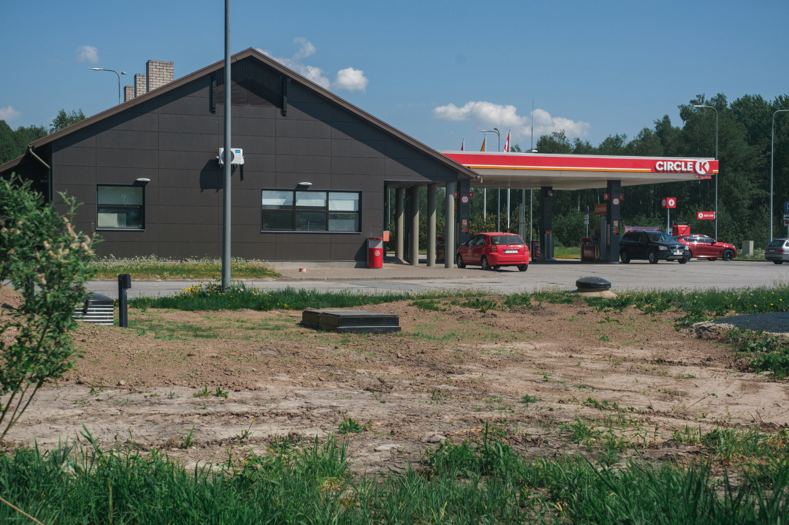
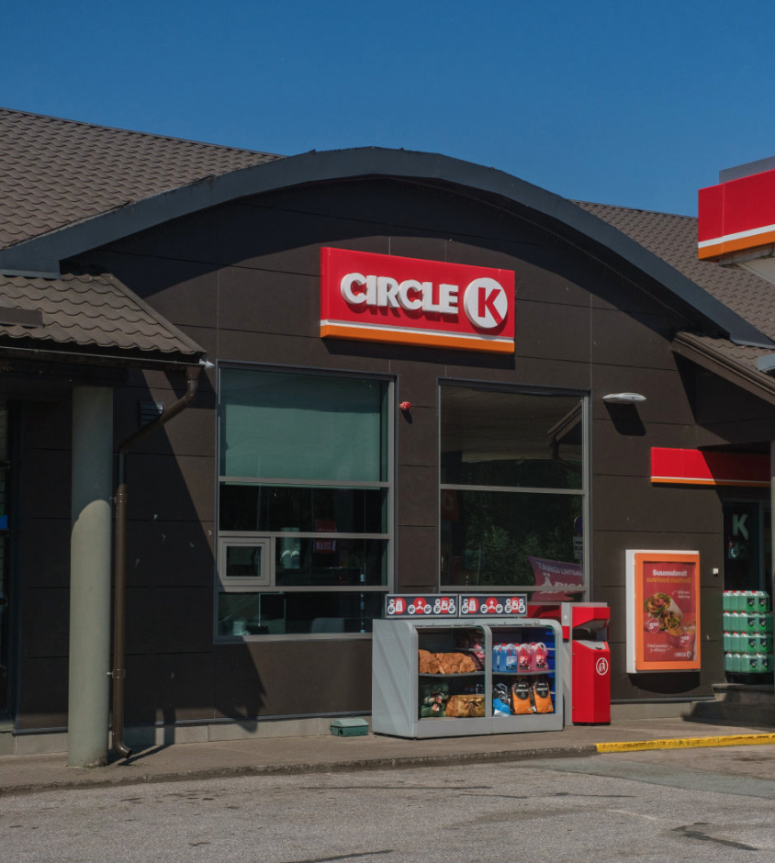
Circle K
14

Slide 16

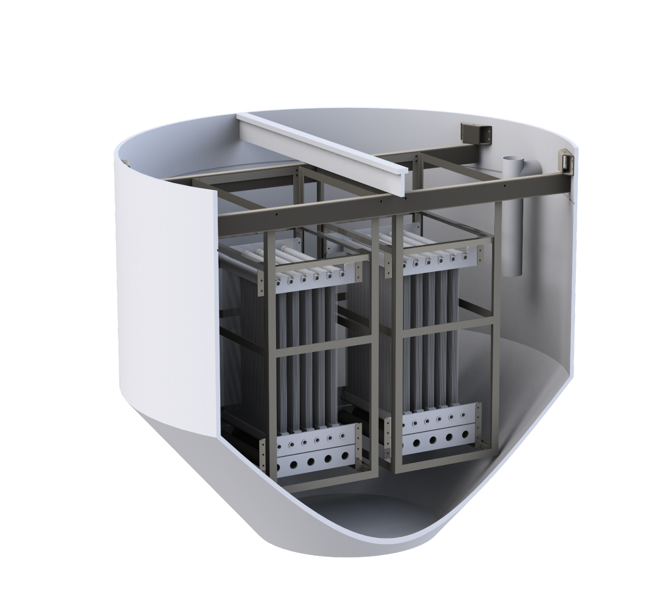
Surju village
The set up
Surju village faced operational difficulties with its wastewater treatment facility, needing reconstruction while preserving the existing infrastructure.
Difficulty in connecting to canal infrastructure
Spacedrip implemented automated wastewater treatment system for 250 people
Treated water directed to nearby Reiu river
Energy consumption ranged from 1 to 1.5 kWh/m³, aligning with project's goals
15

Slide 17
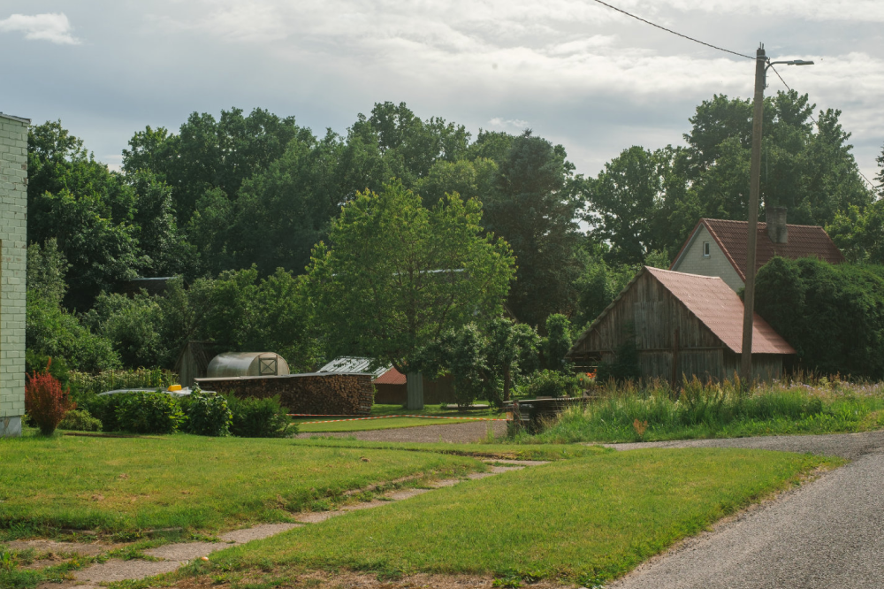
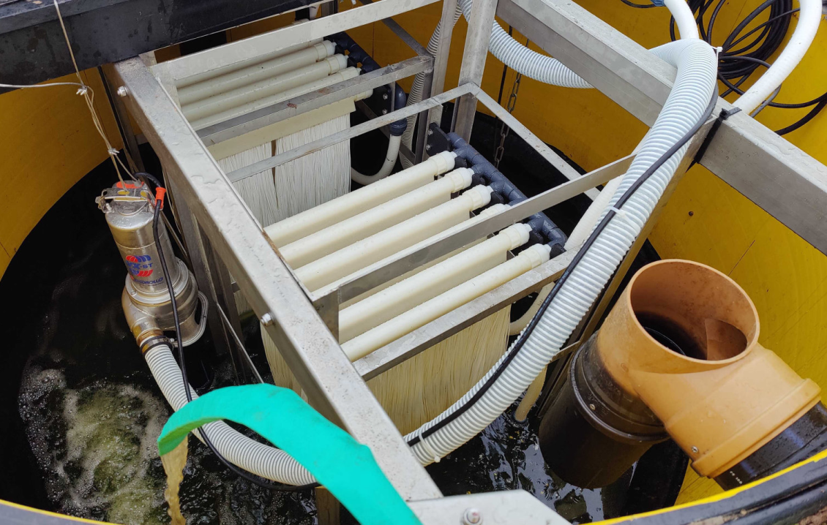
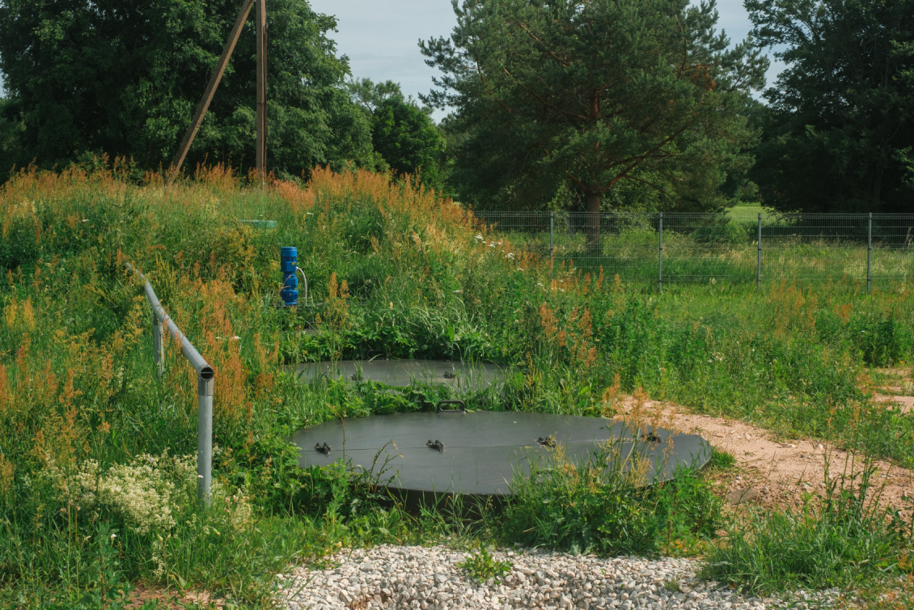
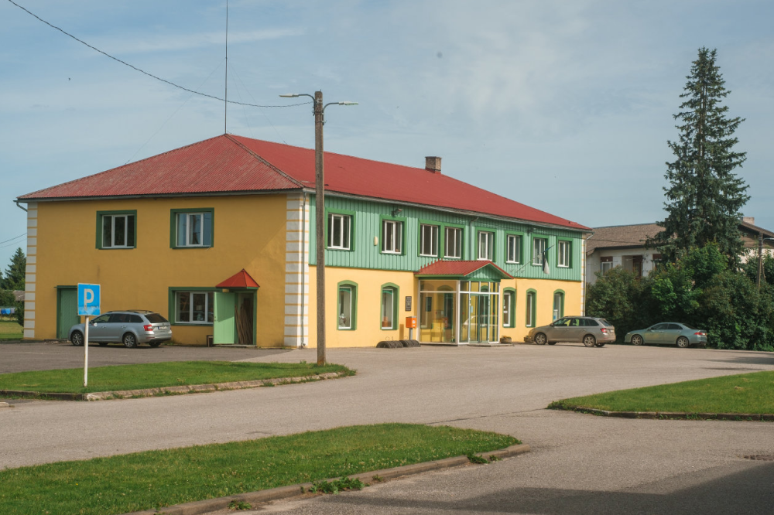
Surju Village
16

Slide 18

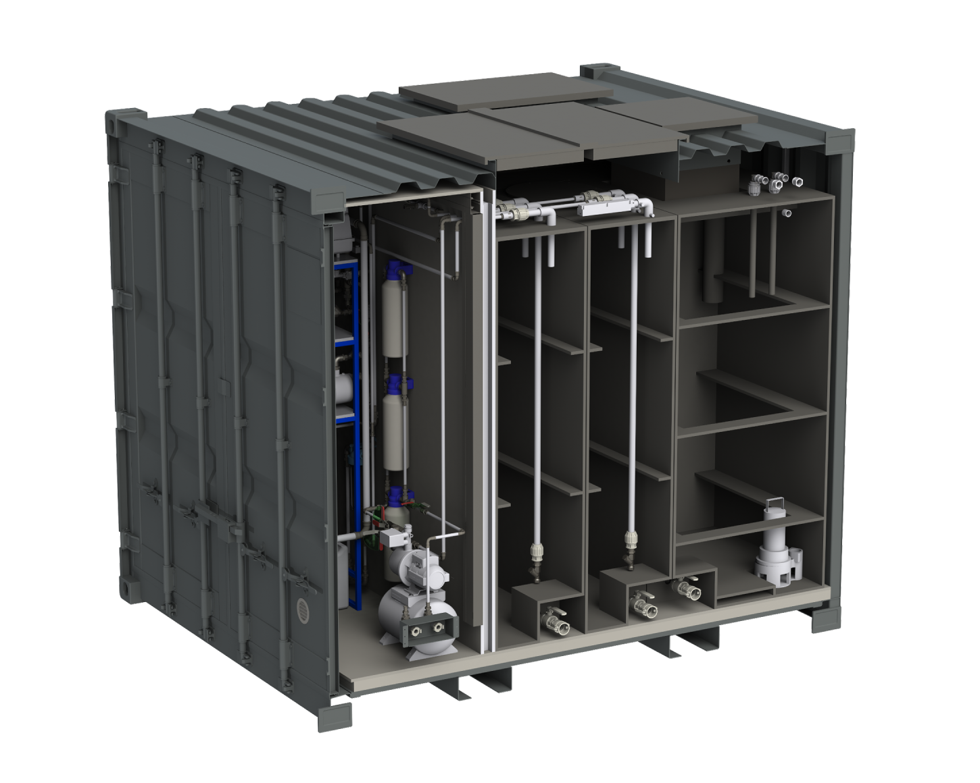

Tactical Foodpack
The set up
The Tactical Foodpack factory in Germany processes freeze-dried food. Currently, the ice and wastewater generated during this process are being sent to the sewage system, posing environmental concerns.
Spacedrip implemented a 10ft containerized system, treating freeze-dried food process wastewater and repurposing it for packaged mineral water and office consumption.
Mobile treatment plant is easily plugged into the production line.
The system treats and reuses up to 1.5 cubic meters of wastewater per day
17

Slide 19
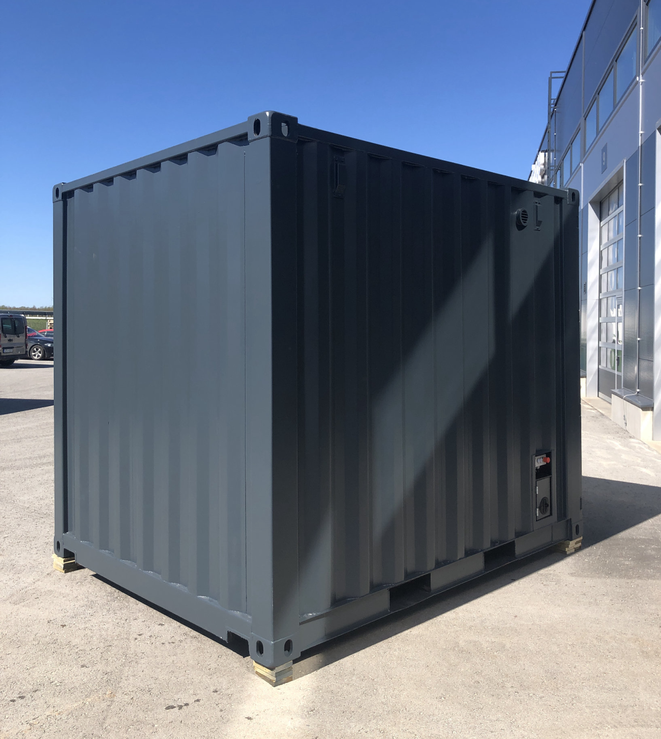
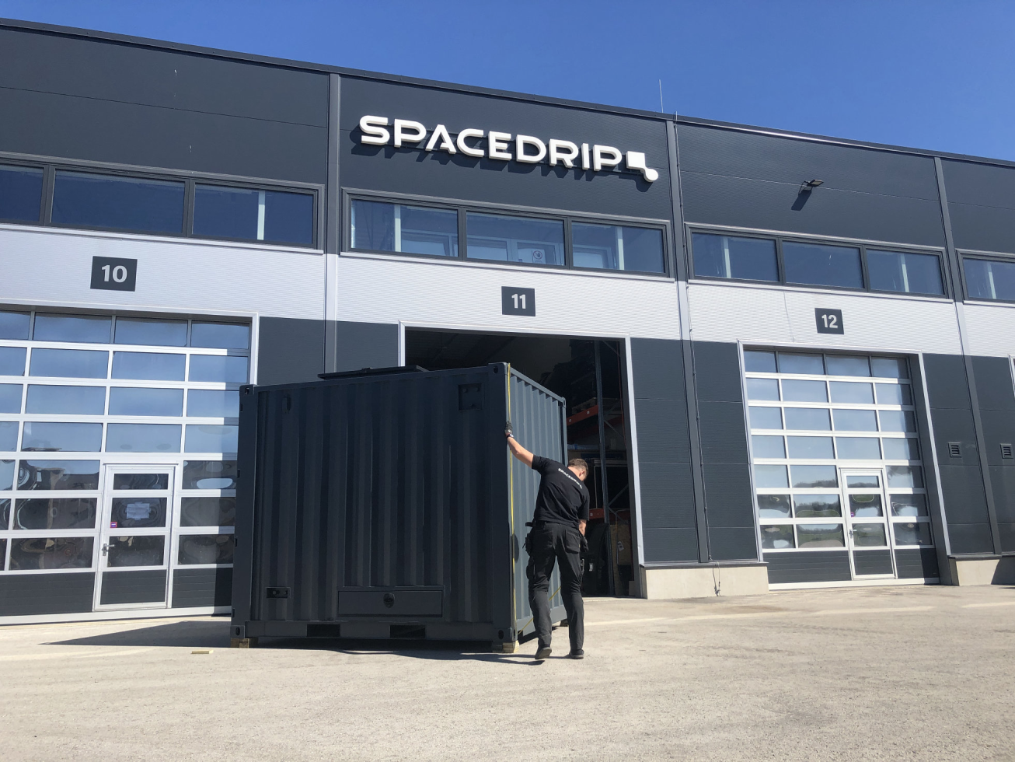
Tactical Foodpack
18

Slide 20
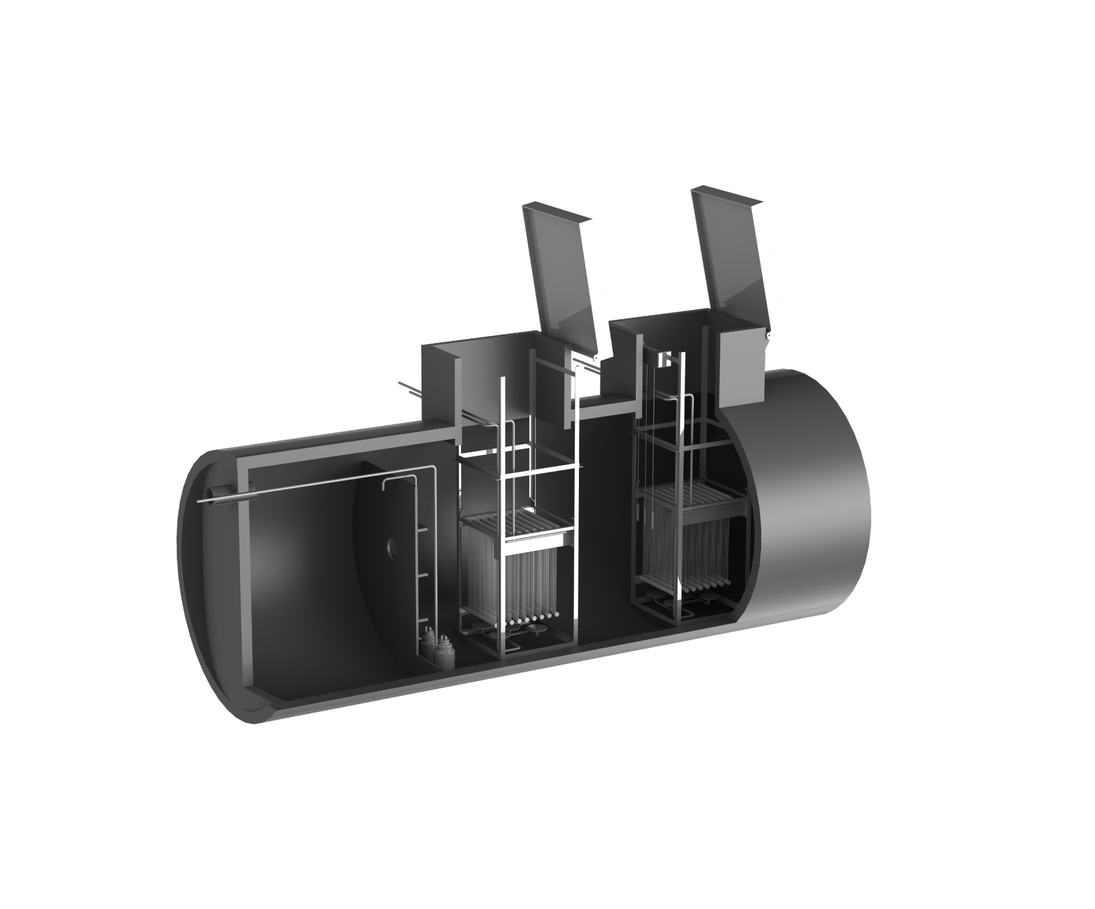
Vasknarva Port
The set up
A small harbour next to a sensitive natural environment requires high-standard wastewater treatment for its newly built harbour building.
We installed an MBR-based system for 30 people in an underground tank, producing non-potable water for reuse in toilet flushing and technical applications.
The system treats up to 5 cubic meters of wastewater daily, with a power consumption of 3 kWh/day.
19

Slide 21
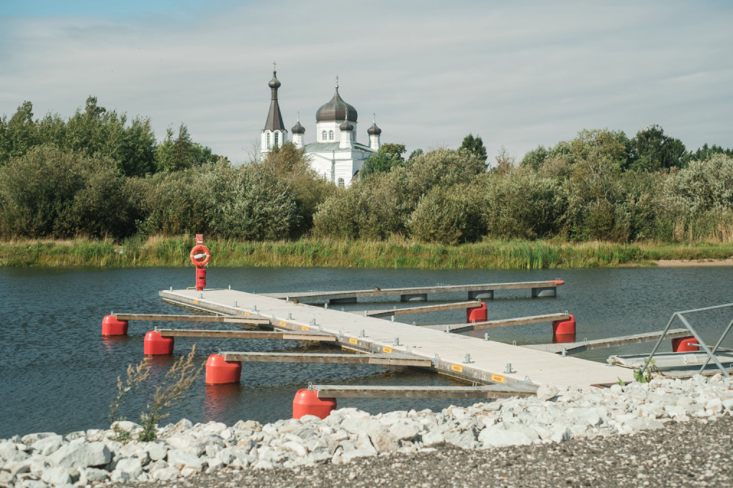
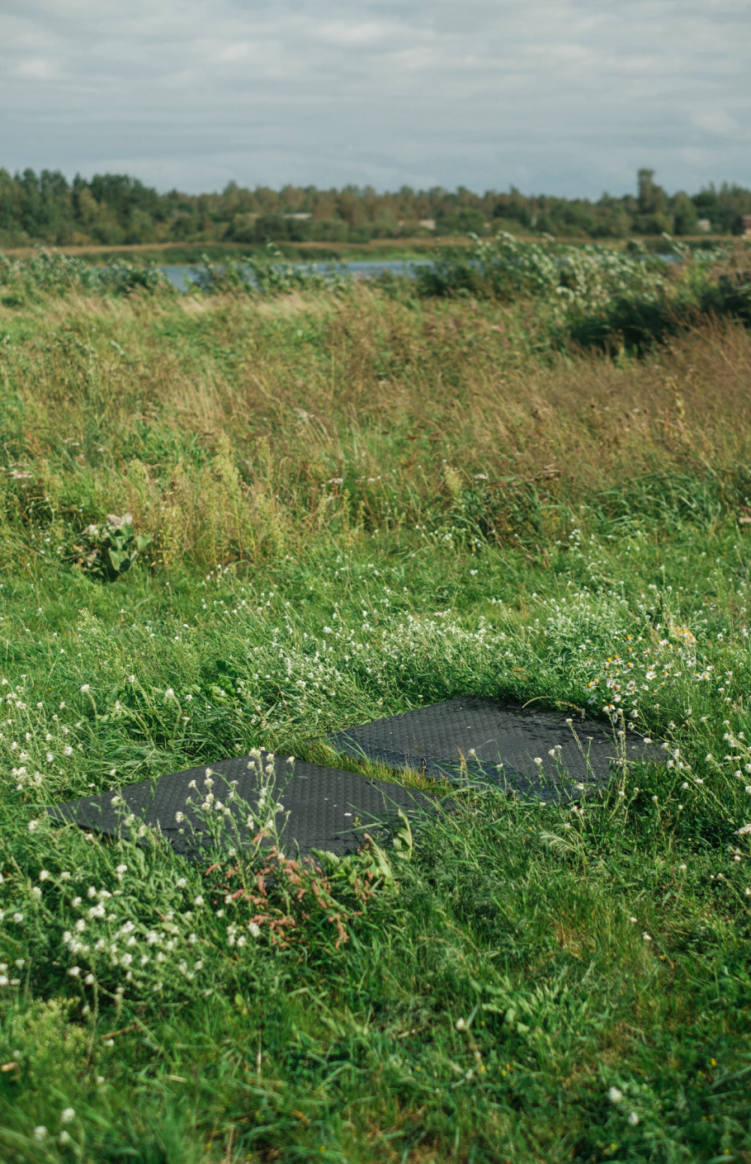
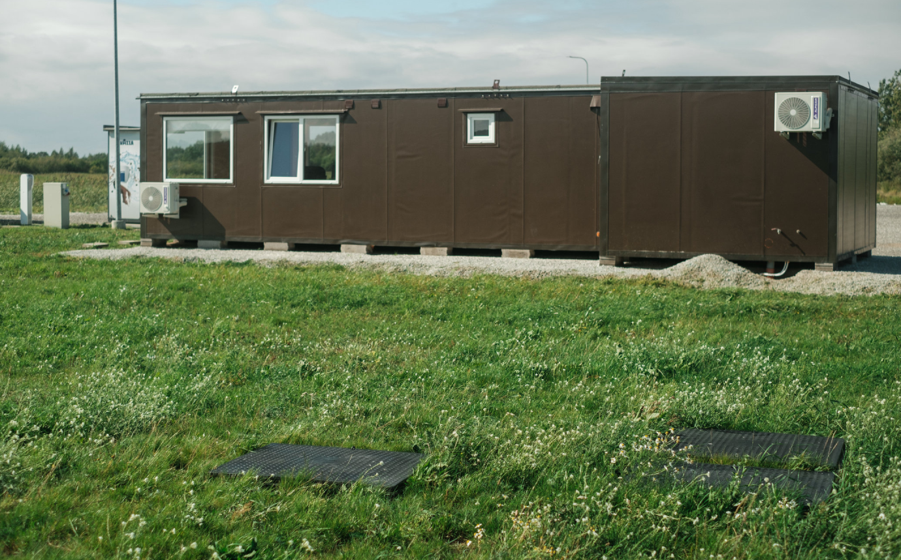
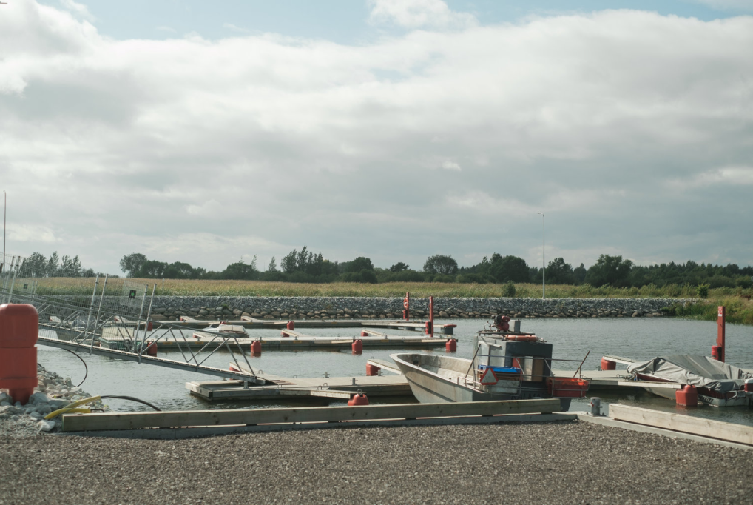
Vasknarva Port
20

Slide 22
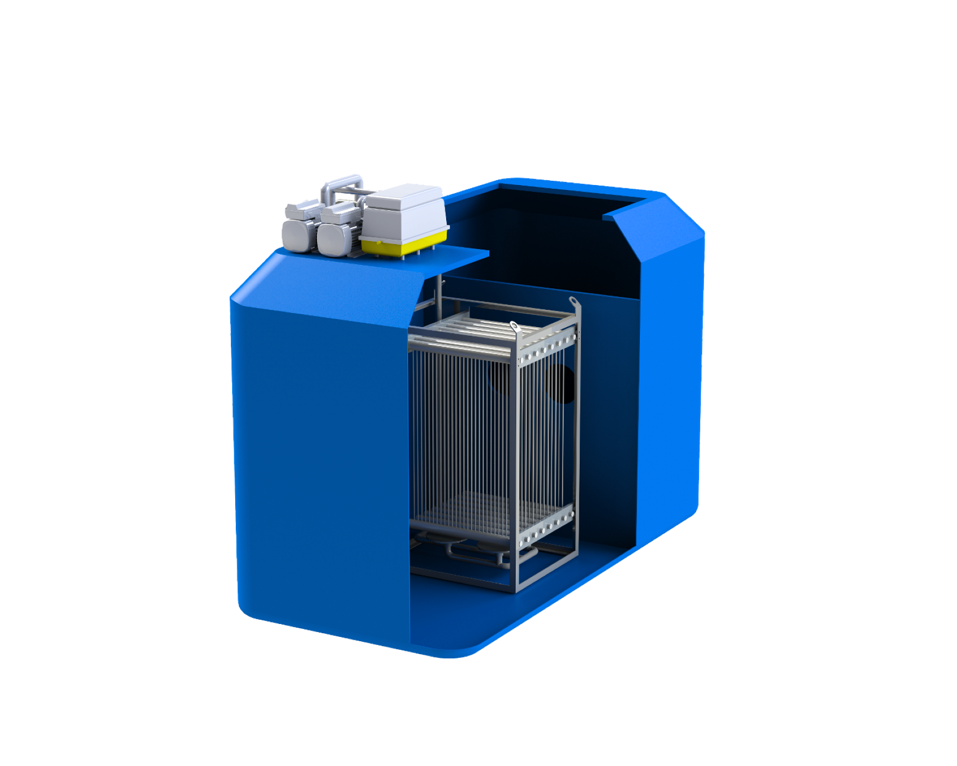
Naissaare Port
The set up
An island harbour requires high-standard wastewater treatment and water reuse to minimize water demand, treating wastewater for 30 people and ships
An MBR-based system in a single underground tank was installed, treating harbour and ship wastewater to produce non-potable water
The system treats up to 5 cubic meters of wastewater daily with a power consumption of 3 kWh/day, demonstrating effective off-grid operation and water reuse
21

Slide 23

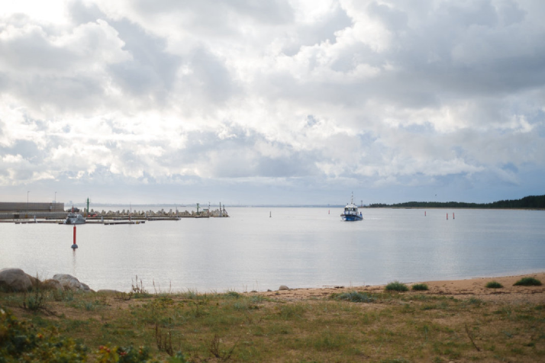
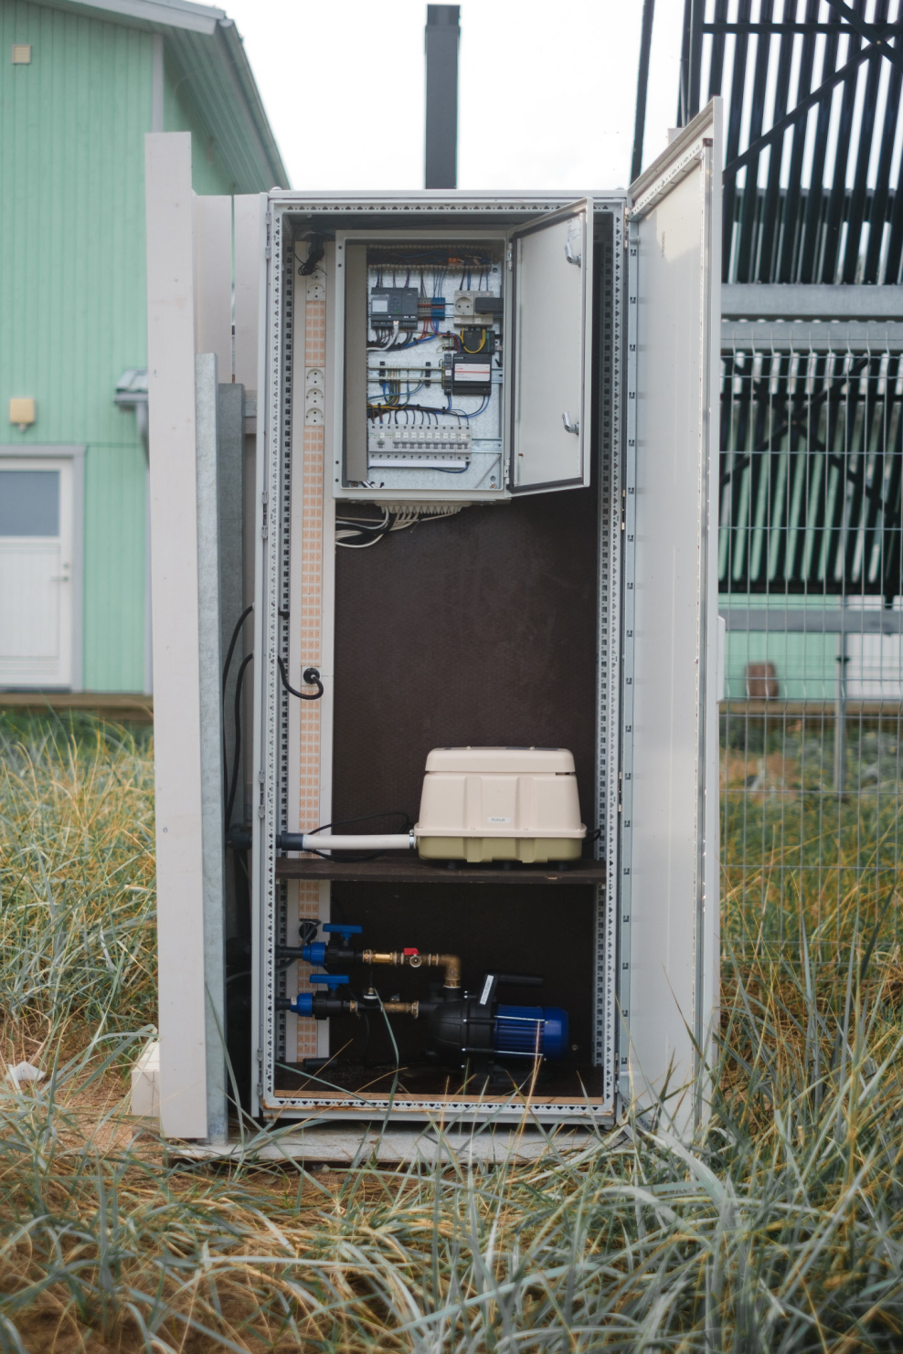
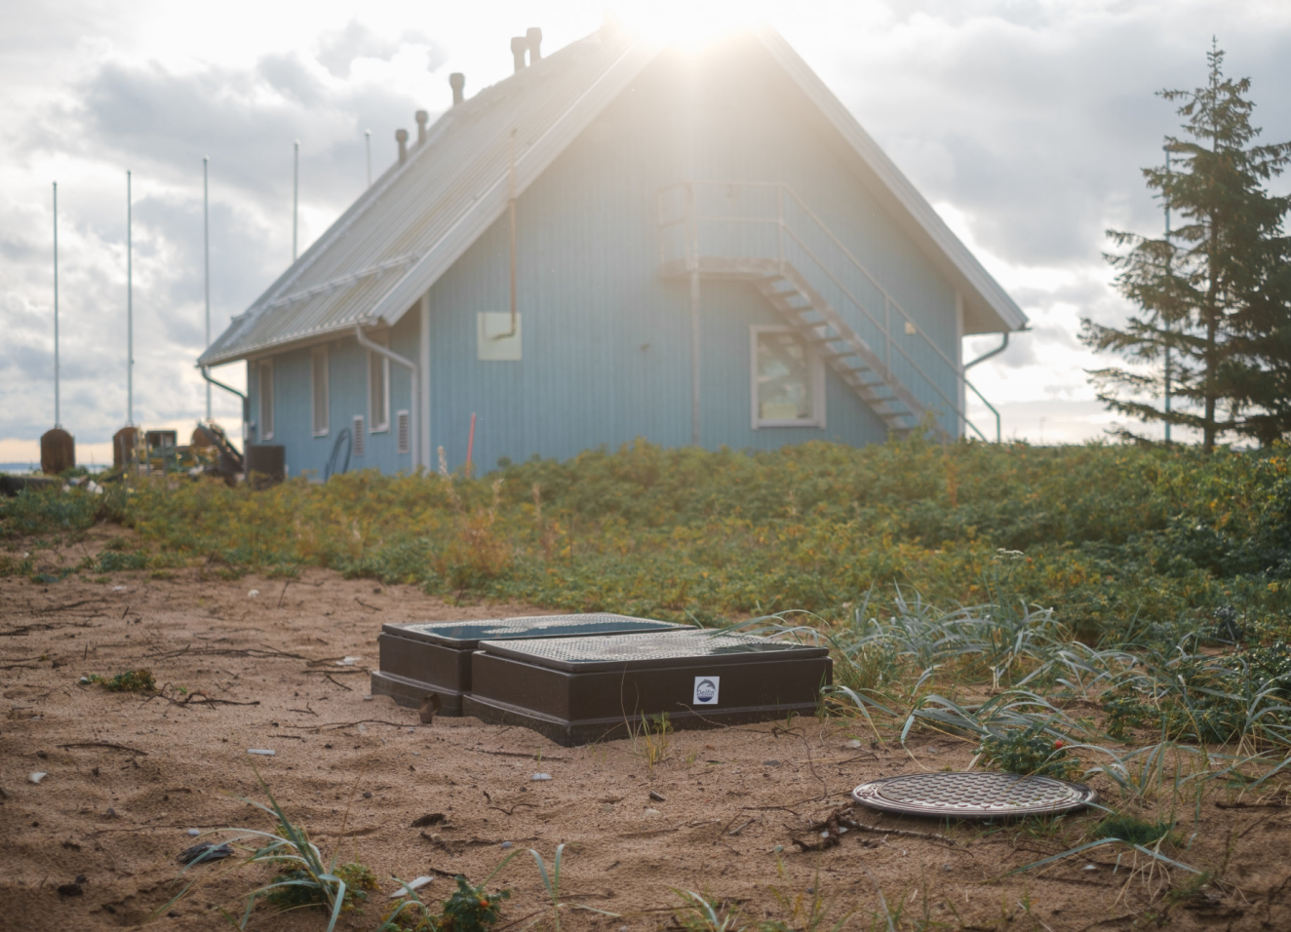
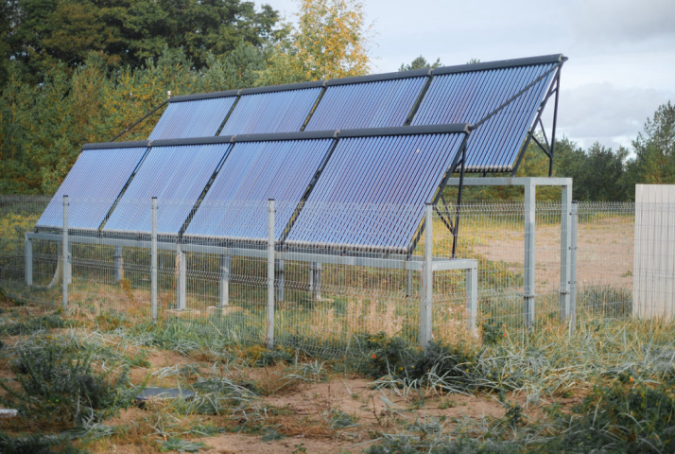
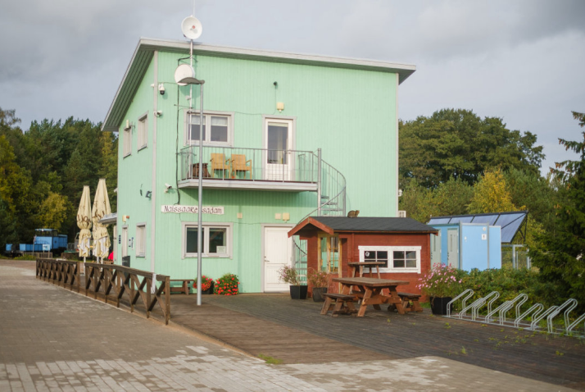
Naissaare Port
22

Slide 24

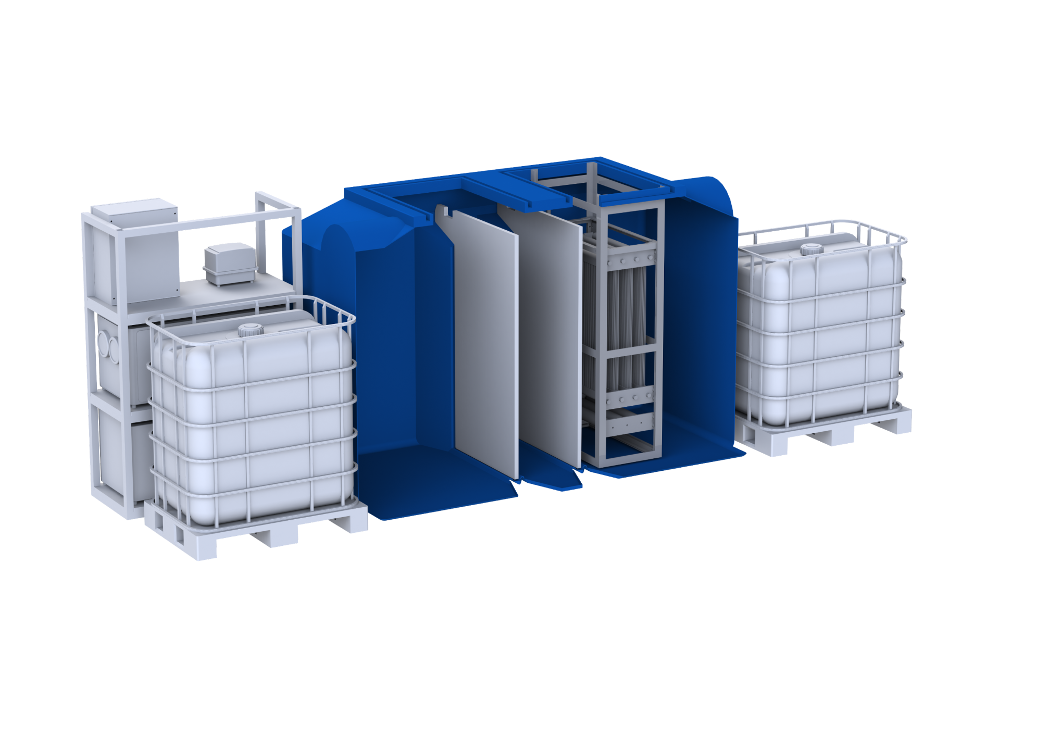

Papermill
The set up
Wastewater treatment was insufficient and no water reuse solutions in Rappin paper edge protector production
A containerized system was implemented for wastewater treatment and water reuse. The pilot system treats and reuses up to 1.5 cubic meters of wastewater per day
Spacedrip is going to offer full-scale solution to treat and reuse up to 240 cubic meters of wastewater per day, installed into 5 pcs of 40ft containers
Spacedrip provides pilot systems for industries to test before full-scale projects
23

Slide 25
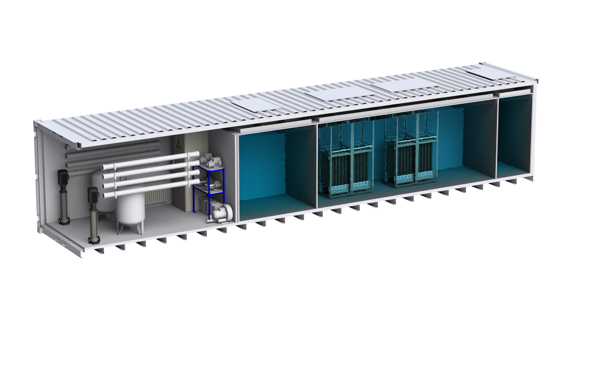
Brewery
The set up
The aim is to achieve brewery ESG targets by reducing water consumption
An all-in-one system housed within a 40ft container with MBR and reverse osmosis technology was implemented
Automated process management through advanced sensors and software
Treated water is used for tank cleaning, filter washing, and can rinsing operations.
The system treats and reuses up to 97 cubic meters of wastewater daily
24

Slide 26







Contact
Filippo Bertoli
James Parrish
Jan Tomingas
Export Sales Manager
Account Manager
Head of Sales and Partnerships
filippo.bertoli@spacedrip.com
james.parrish@spacedrip.com
jan.tomingas@spacedrip.com
+372 5887 9262
+372 5656 7175
+372 5620 3647
+39 391 7585 174
@spacedrip
www.spacedrip.com

